Slide 1

Brain Algorithms READING GROUP SPRING, 2023
Meeting 13

Slide 2
Symbolic Knowledge Structures and Intuitive Knowledge Structures
Thesis: Two distinct types of knowledge structures are present in the brain:
Symbolic Knowledge Structures (SKSs), used for formal, symbolic reasoning.
Intuitive Knowledge Structures (IKSs), used for drawing informal associations.
Paper contains preliminary ideas for modeling, analyzing these using SNNs, and two examples.
Much more to be done, to complete the theory, and to relate to actual brains.

Slide 3
1. Introduction
Original motivation: Understanding how language is processed in the human brain.
More generally, how symbolic reasoning is carried out, and how it relates to intuitive reasoning.
Based on two hypothesized structures: Intuitive Knowledge Structures and Symbolic Knowledge Structures.
IKS: Represents informally-understood concepts and relationships, supports informal associations between concepts.
SKS: Represents symbols (numbers, words,…), supports formal, logical reasoning.

Slide 4
Introduction
SKS and IKS are used in language processing.
Also other types of processing:
Sequence of symbols, each corresponding to a concept (Greek letters for virus variants or hurricanes).
Planning a construction project, e.g., a plumbing system.
Here, consider abstract models and algorithms, not actual areas of the human brain; later, relate to brain areas.
SKS should be implemented using reliable neurons, with reliable connections, IKS could use less reliable neurons, with noisy connections.
Key difference between humans and other animals?
Notes:
After first bullet:
SKS includes precise representations of linguistic elements such as words and parts of speech.
It also encodes formal structures such as parse trees, and other relationships between linguistic elements.
IKS includes imprecise representations of concepts that are denoted by words and sentences, such as pictures and simple stories. It also encodes informally-understood relationships between concepts.
-----------
Key difference between humans and other animals?
Both humans and many animals utilize intuitive knowledge and computation to understand their world and plan their activities.
Humans also make extensive use of symbolic knowledge and computation.
Animals don’t do this very much, exc. primitive symbolic capabilities in some monkeys.

Slide 5
References
Nancy Lynch. Symbolic Knowledge Structures and Intuitive Knowledge Structures. arXiv:2206.02932, 2022.
Kahneman. Thinking, Fast and Slow. 2011.
Our SNN models:
Nancy Lynch and Cameron Musco. A Basic Compositional Model for Spiking Neural Networks. arXiv: 1808.03884v3, 2022.
Nancy Lynch, Frederik Mallmann-Trenn. Learning Hierarchically Structured Concepts. Neural Networks, 143:798-817, 2021. Also, arxiv:1909.04559v5, 2021.
Language background:
Angela Friederici. Language in our Brain.
Berwick and Chomsky. Why Only Us.
Notes:
SNN model:
Also mention Lili paper, for keeping history info.
Hierarchical:
And new OF paper.

Slide 6
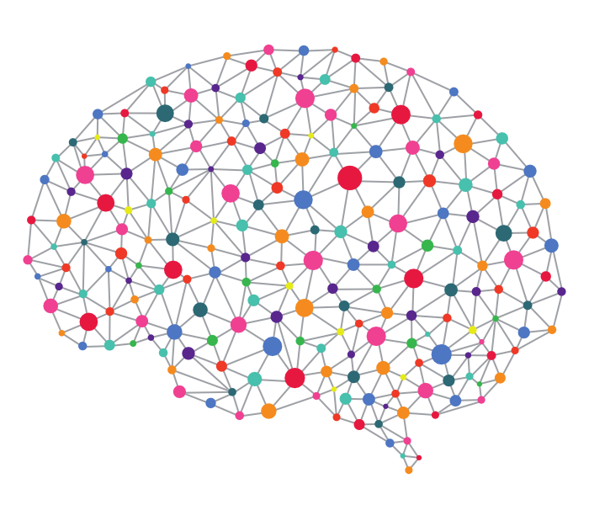
Spiking Neural Networks
Have bio-plausible features, but simple enough to study theoretically.
Each neuron fires in discrete spikes, in response to incoming membrane potential.
Potential is induced by spikes from neighboring neurons; influence can be excitatory or inhibitory.
Our model: Neurons operate in synchronous rounds, fire stochastically.
Notes:
Now describe our model.
Stochastic firing reflects noisiness of neural computation.

Slide 7
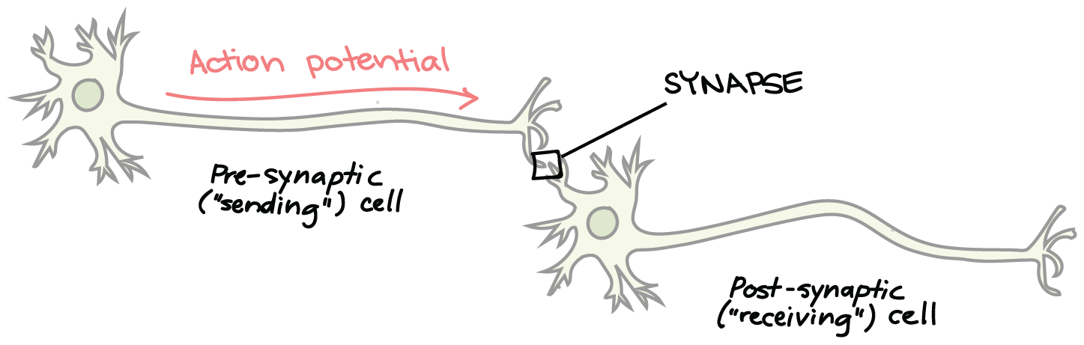
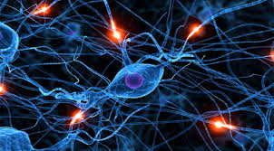
Our Basic SNN Model
Network structure: Weighted digraph, nodes represent neurons, edges represent synapses, weights represent synaptic strength.
$$u$$
$$v$$
Notes:
The first picture shows a synapse being modeled by an edge.
The second shows an entire brain being modeled by a graph.
Should be a directed graph though.

Slide 8
SNN model
$$0$$
$$1$$
$$1$$
$$0$$
…
$$x1$$
$$x2$$
$$x3$$
$$xn$$
Network consists of:
Input, output, internal (auxiliary) neurons
Directed edges
Weights for edges
Activation bias for neurons
$$3$$
$$as$$
$$ac$$
1
-1
$$y1$$
$$y2$$
$$y3$$
…
$$yn$$
2
Neurons have state.
In our basic model this is just the (Boolean) firing status.
Ignores biological features such as accumulated potential and refractory periods after firing.
Sometimes we add other state information (memory, modes).
Notes:
Allows self-loops
Positive weights are excitatory, negative weights are inhibitory.
Input neurons have no incoming edges from within $N.$
Their behavior is determined externally.
---------------------------------------------------
Memory:
Refractory period, delay, involve some memory of recent events.
In some of our papers, we do allow some limited memory.
This required generalizing the model.

Slide 9
SNN model dynamics
Synchronous rounds.
Firing probability of a neuron at time $t$ depends on firing of incoming neighbors at time $t−1$:
$u_{t}=1: u$ fires at time $t.$
$pot\left(u,t\right)=Σ_{v} weight\left(v,u\right) v_{t−1 }– bias(u)$
$Pr⁡[u_{t}=1]$ $= 1/(1+e^{−pot\left(u,t\right)/λ})$
$λ=$ temperature (steepness)
Input is an infinite sequence of firing patterns of input neurons.
For a given input, network produces a probability distribution on executions.
Firing probability
1
1/2
$$Potential$$
Notes:
The summation here is over the incoming neighbors v of u.
Temperature parameter: Smaller values of lambda yield steeper functions.
With very small lambda, u acts similarly to a probabilistic threshold gate: probability of firing = ½ when potential = bias(u), else 1 or 0.
To model reality, we might be forced to use particular values of $λ$, based on real neuron behavior.

Slide 10
Compositional Model for SNNs
Formal math foundation for modeling and reasoning about synchronous, stochastic SNNs.
Basic model: Neuron state contains firing status only.
External behavior of an SNN.
Composition operator, supports modeling SNNs as combinations of smaller SNNs.
Hiding operator, reclassifies some outputs as internal.
Proved that these operators respect external behavior.
General notion of a problem to be solved by an SNN.
Proved that the operators respect the problems solved.
Notes:
We are developing concurrency-theory foundations for SNN-based algorithms.
In our basic model, a neuron state contains firing status only (Boolean, firing/not-firing).
This paper deals with just the basic model.
Some of our algorithmic work uses extensions to the basic model, in which neurons have more elaborate state:
History of firing or potential.
Modes of operation, e.g., ready-to-learn.
Future work should involve extending the definitions and results of this paper to accommodate such extensions.
-----------------------------------------------------
Definitions and results:
Theorems saying that these operators respect the external behavior: e.g., external behavior of composition of networks depends only on the external behavior of the individual networks, and not on any internal behavior.
This type of foundational result is needed to support a compositional theory.

Slide 11
Composition Operator
Supports combining networks that solve simple problems into larger networks that solve more complex problems.
Lesson from some of our earlier work on Probabilistic I/O Automata: To get compositionality, we must resolve nondeterminism carefully.
Here, synchrony removes all timing nondeterminism, internal choices are stochastic; nondeterminism is limited to input.
Example: Attention network:
Allows the brain to focus on one input stream out of several that arrive in parallel.
Composed of a WTA that selects one stream, and a Filter network that passes on inputs from selected streams.
$${ w}_{1}$$
$${ w}_{2}$$
$${ w}_{3}$$
$${ x}_{1}$$
WTA
$$y_{1}$$
Filter
$$x_{2}$$
$$y_{2}$$
$$x_{3}$$
$$y_{3}$$
$${ z}_{1}$$
$${ z}_{2}$$
$${ z}_{3}$$
Notes:
We would like to be able to describe neural networks compositionally---that would certainly make the algorithms easier to understand.
It’s an open question to see where real brain activities follow such decomposition.

Slide 12
SNN Model
Firing pattern for a set $V$of neurons: Maps $V$ to$\left\{0,1\right\},$ where $1 i$ndicates “firing”.
SNN consists of:
$N,$neurons, partitioned into $N_{in}, N_{out}, N_{int}$.
$N_{ext}= N_{in}∪ N_{out}$.
Each non-input neuron has a real-valued $bias.$
$E$, directed edges between neurons.
Input neurons have no incoming edges.
Allow self-loops on non-input neurons.
Each edge has a real-valued $weight.$
$F_{0}$, initial firing pattern for non-input neurons.
Notes:
And now, a few details.
This follows the general style used for I/O automata modes, but with input/output neurons instead of input/output actions.

Slide 13
Executions
Configuration: Firing pattern for the entire set $N$ of neurons.
Project configuration $C$ on any subset $M$ of $N$, $C ⌈ M.$
Initial configuration$:$ $C ⌈ {{(N}_{out} ∪ N_{int}\text{)} = F}_{0}$.
Network operates in synchronous rounds.
Execution: Finite or infinite sequence $C_{0},C_{1},…$where $C_{0}$ is an initial configuration.
Project execution $α$ on any subset$M$ of $N$, $α ⌈ M.$
$Trace\left(α\right)=α ⌈ N_{ext}.$
Trace of the network : Trace of any execution.
Notes:
Configurations:
Input configuration, output configuration, internal configuration, external configuration, non-input (lc) configuration.
Initial values for the lc (output and internal) neurons are as specified for the initial firing pattern.
----------------------------------------------------
Executions:
Executions are not probabilistic---they just describe what happens in one run of the network.
Here we allow any sequence of configurations---we have no “transition function” to restrict these.
This is because all configurations are possible---any firing behavior has some nonzero probability of occurring, however small.
Length of $C_{0},C_{1},…,C_{t}$= $t.$

Slide 14
Probabilistic Executions
Define a probabilistic execution for any infinite input execution $β_{in}.$
A probability distribution $P$ on the set of infinite executions consistent with $β_{in}.$
All start with the same initial configuration $C_{0}.$
Based on defining probabilities for “cones” $A(α)$, for all finite executions $α$ that are consistent with $β_{in}.$
$A\left(α\right)=$infinite executions that are consistent with $β_{in}$ and extend $α:$
$$A(α)$$
$$α$$
Notes:
What we discussed so far was not probabilistic, just a single execution.
Now we introduce probabilities.
We want a probability distribution on executions; this means we must remove all nondeterminism.
To do this, we fix the input execution beta_in.
Which executions to consider?
Those consistent with beta_in.
We say that infinite execution alpha is consistent with beta_in if alpha \lceil N_in = beta_in.
For a finite execution, alpha \lceil N_in should be a prefix of = beta_in.
Same initial configuration because we use the first (input) config from beta_in and F_0 for all the non-input neurons.
The general style of the definitions follows Segala’s work.

Slide 15
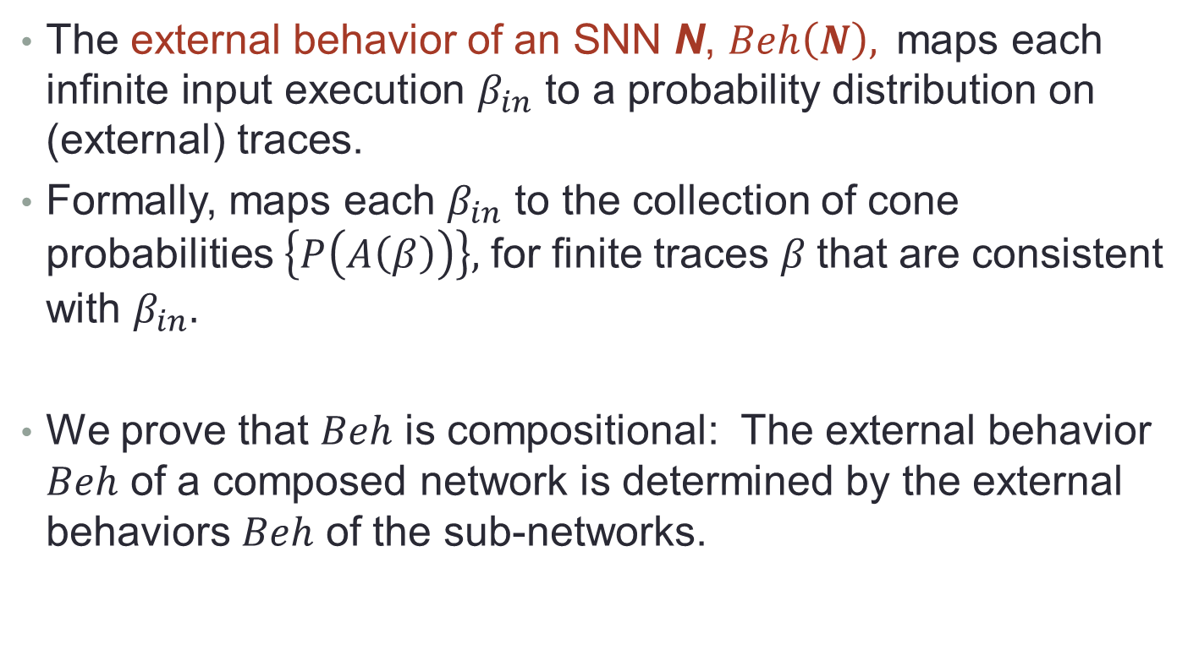
External Behavior
The external behavior of an SNN N, $Beh\left(N\right), \text{maps} \text{each} \text{infinite} \text{input} \text{execution} β_{in} \text{to} \text{a} \text{probability} \text{distribution} \text{on}\text{ (}\text{external}\text{) }\text{traces}\text{.}$
Formally, maps each $β_{in}$ to the collection of cone probabilities $\left\{P\left(A\left(β\right)\right)\right\},$ for finite traces $β$that are consistent with $β_{in}.$
We prove that $Beh$ is compositional: The external behavior $Beh$ of a composed network is determined by the external behaviors $Beh$ of the sub-networks.
Notes:
That is, for each infinite input execution, we get the probability distribution on executions, concretely expressed in terms of the cone probabilities.
We project this on the external neurons to get a probability distribution on the (external) traces.
In the rest of the talk, I define the needed notions and state the compositionality results.

Slide 16

Composition of SNNs $N^{1}$and $N^{2}$:
Compatibility:
No internal neuron of $N^{1}$ is a neuron of $N^{2},$ and vice versa.
No neuron is an output neuron of both $N^{1}$and $N^{2}.$
($N^{1}$and $N^{2}$may have common input neurons, and outputs of one may be inputs of the other.)
Composition $N=N^{1}×$ $N^{2}$ of compatible networks:
Take unions for neurons, output neurons, internal neurons.
An input neuron of one network that is an output of the other becomes an output in $N;$ other inputs remain inputs in $N$.
Take union for the edges.
Initial non-input firing pattern of $N$ is inherited from those of $N^{1}$and $N^{2}.$
Notes:
Two networks, for simplicity.
We can generalize to more networks, or just use repeated 2-network composition.
---------------------------------------------------------------
Compatibility:
These natural conditions are directly inspired by those used in I/O automata models.
Composition definition:
Since $N=N^{1}×$ $N^{2}$ is just another SNN, we automatically have definitions for its executions and probabilistic executions.

Slide 17
Compositionality
An external behavior definition $B$ assigns a behavior object $B(N)$ to each network $N.$
$B$ is compositional provided that $B\left(N^{1}×N^{2}\right)$ is uniquely determined by $B\left(N^{1}\right)$and $B\left(N^{2}\right):$
Assume $N^{1}, N^{2}, N’^{1}, N’^{2}$, where $N^{1}$and $N’^{1}$ have the same input and output neurons, and likewise for $N^{2}$ and $N’^{2}$. Assume compatibility.
If $B\left(N^{1}\right)=B(N^{′1})$ and $B\left(N^{2}\right)=B(N^{′2})$, then $B\left(N^{1}×N^{2}\right)=B\left(N^{′1}×N^{′2}\right).$
We prove that our external behavior $Beh$is compositional.
Notes:
Beh: Mapping from inputs to probability distributions on traces.
If one behavior notion is compositional, then any “equivalent” behavior notion is also compositional.
This relies on the definition of equivalence for behaviors.

Slide 18
2. Model: Symbolic and Intuitive Knowledge
Main parts:
IKS, for intuitive concepts and their informal relationships,
Lexicon, for symbols and some of their basic attributes, and
SKS, for symbols and their formal relationships.
SKS connects to Lexicon and IKS.
SKS and IKS connect to input and output facilities, via special input and output neurons.
Also, limited amount of Working Memory—neurons that can point to particular symbols or intuitive concepts.
May represent “roles” (current number in a sequence, subject of a sentence,…)
Notes:
Working memory:
Points to symbols and intuitive concepts that the brain is currently focusing on.
These Working Memory neurons may represent special “roles” being played by the symbols or concepts, such as the “current number” in a series of numbers, a partial result in an arithmetic calculation, or the subject in a sentence.

Slide 19
Model
Outputs
Lexicon
SKS
IKS
Inputs
Working Memory

Slide 20
Model
IKS supports intuitive reasoning, which is more like following associations.
SKS supports logical, precise reasoning.
IKS is present in many animals.
Lexicon and SKS are mostly characteristic of humans.
Outputs
Lexicon
SKS
IKS
Inputs
Working Memory
Notes:
The IKS contains entities (neurons, or collections of neurons) that represent intuitive concepts. Reasoning using the IKS is intuitive reasoning, which I might not even call “reasoning”—it is more like just following associations.
The SKS contains entities that represent symbols. Reasoning using the SKS is logical, rather precise reasoning.
---------------------------------------------------------
Animals vs. humans:
I believe that the IKS is present in nearly all animals, not just humans. The Lexicon and the SKS, however, seem to be (mostly) characteristic of humans. Some research indicates that some apes (Bonobo, e.g.) may have rudimentary versions of these two structures, allowing them to process some symbols and perhaps perform some elementary symbolic manipulations.
But in general, these structures are reserved for humans.
Q: True? Maybe some other kinds of animals?
-------------------------------------------------------------
Modeling:
In the rest of Section 2, I sketch how we might model the various components formally.
My starting point is the synchronous, stochastic Spiking Neural Network (SNN) model of Lynch and Musco.
I expect that we will want to augment this model to include recent history, learning readiness, and other features.

Slide 21
2.1. IKS Model
Concept neurons and directed connections between them.
Neurons, connections may be unreliable.
Q: Can we model the IKS at two levels of abstraction, where the lower level “implements” the higher level?
Higher level: Individual neurons, one per concept, some directed edges.
Lower level: Multiple neurons per concept (population model).
Lower-level model with unreliable neurons can implement a higher-level model with more reliable neurons (using redundancy).
High-level
IKS model
Simulation
relation
Low-level
IKS model
Notes:
Lower level related to Papadimitriou’s work, Valiant’s work.

Slide 22
Higher-level IKS model
Dynamic weighted digraph, nodes = concept neurons.
SNN model, similar to [Lynch, Musco 2022], edge weight changes as in [Lynch, Mallmann-Trenn 2021].
Unreliability, in neurons and connections:
Neurons: Sigmoid functions yield stochastic behavior; can associate failure probability with each neuron.
Edges: Probability distribution for potential on each edge; failure probability for each edge.
Q: Other failure modes?
IKS may be constructed using Join (Merge), Associate (Link).
IKS may include edge labels, such as parent/child, successor/predecessor in sequence, subject/predicate of a sentence.
Notes:
This graph serves as the basis for a neural network model: at each round, each neuron exhibits firing behavior based on its total incoming potential, which is the sum of the weights of the incoming edges from currently-firing incoming neighbors.
The graph is dynamic: it may change over time as concepts get learned, get seen together, get seen in apparent causal relationships, and so on.
----------
Unreliability:
To model unreliability in neurons, note that the sigmoid function that is used in translating incoming potential to firing probability yields stochastic behavior; shallower sigmoid functions yield more uncertainty. We might also associate a failure probability with each neuron; failure of a neuron might mean that it doesn’t fire even if its incoming potential indicates that it should, or fires even if it is not supposed to.
To model unreliability in connections, we might introduce a probability distribution for the potential conveyed on each edge, rather than using a fixed value. We might also associate a failure probability with each edge; failure of an edge might mean that it doesn’t convey potential, or conveys a different potential from what it should.
We might consider other failure modes, temporary or permanent.
----------
Constructing the IKS:
I imagine that the IKS is constructed using operations like those presented by Valiant, and Papadimitriou and Vempala , notably Join/Merge.
Performing a Join/Merge involves creating an entirely new concept that is built from other concepts, that is, a hierarchical concept.
Another operation is Associate/Link.
Other structural relationships that might appear in the IKS include causality and temporal predictions.
----------
Additional structure:
We will sometimes want additional structure in the IKS, besides just neurons and directed edges.
For example, we might want to include the information that one concept neuron is a “child” of another concept neuron. That is, we might classify some of the directed edges as parent edges or child edges, as in work by L and M-T.
For a sequence, we might have successor edges and predecessor edges.
For a sentence, we might have subject edges and predicate edges.
Other labels might be appropriate for other kinds of relationships.

Slide 23
Operations on higher-level IKS model
Direct recognition of concepts:
Input presented, in some format.
Causes particular neuron or neurons to fire, automatically.
Millisecond-scale latency (Kahneman’s fast thinking).
Might also trigger outputs.
Indirect recognition of concepts:
Input presented, triggers cascade of neurons to fire.
Automatic, fast.
Might trigger outputs.
Learning of concepts or relationships:
Learning a new concept: WTA, modify edge weights.
Reinforcing a concept: Modify edge weights.
Learning/strengthening relationships: Modify edge weights.
Can be moderately slow.
Notes:
Direct recognition of concepts:
When an input is presented for one of the concepts in the IKS (in whatever form we allow for inputs, see Section 2.4), it can cause a particular neuron, or neurons, to fire.
This should happen very fast, in milliseconds.
This might also trigger some outputs (in whatever form we allow for outputs, see Section 2.4). This kind of operation corresponds to recognizing something directly, and responding in some automatic way.
This is “fast thinking”, in Kahneman’s terminology.
---------------------------------------------------------------------------------------------------------------------------
Indirect recognition of concepts:
An input is presented, but instead of causing immediate recognition, it triggers a cascade of neurons firing.
This might eventually result in an output.
This overall process should still be fast, because each link is fast, as long as we are not talking about too long a chain of links.
This corresponds to producing a collection of associations for the input concept.
This is still “fast thinking”, in Kahneman’s sense, since it is automatic, and each step of the cascade is very fast.
The behavior the network exhibits in such a cascade is as follows:
Input of some sort arrives, triggering some particular concept neurons to fire. These cause potential to flow to their outgoing neighbor concept neurons. If these receive enough potential, they fire with some probability, based on their sigmoid firing function (and possibly other uncertainty).
Thus, the effect of inputs is somewhat unpredictable, based on how this uncertainty is resolved.
The overall result from the input is a somewhat unpredictable cascade of firing of related concepts.
-----------------------------------------------------------
Learning of concepts or relationships:
Some concept or relationship inputs are presented, causing new concepts or new relationships to be learned. Also, already-learned concepts and relationships could have their representations strengthened when they are presented again.
Learning a new concept should involve associating the new concept with an unused internal neuron, plus strengthening the weights of edges that connect the input neurons encoding the concept to the internal representing neuron (and weakening others).
This process might use a Winner-Take-All mechanism to select a suitable unused neuron, as in [L, M-T].
Reinforcing a concept should involve modifying these edge weights.
Learning a new relationship between two concepts, or strengthening an existing relationship, should involve increasing the weights of edges that connect the concepts to each other.
These learning operations should be fairly slow—seconds, or minutes. They use some form of Hebbian learning, such as Oja’s rule [10]

Slide 24
Remarks:
IKS outputs:
We identify some IKS neurons as output neurons.
Can represent decisions, or evaluations of a situation as “good”, “neutral”, “bad”, “terrible”.
Can trigger emotional responses, like “happy”, “sad”, “scared”, “angry”, by activating other neurons outside the IKS.
Connection with Valiant’s work:
All of this corresponds well with Valiant’s work on the neuroidal model, except that he allows multiple representations for concepts.
Notes:
Among the concept neurons in the IKS, we can identify some as output neurons, which represent certain decisions.
For example, the decision may be an evaluation of a situation as “good”, “neutral”, “bad”, or “terrible”.
These neurons can also trigger emotional responses, by activating other neurons outside the IKS.

Slide 25
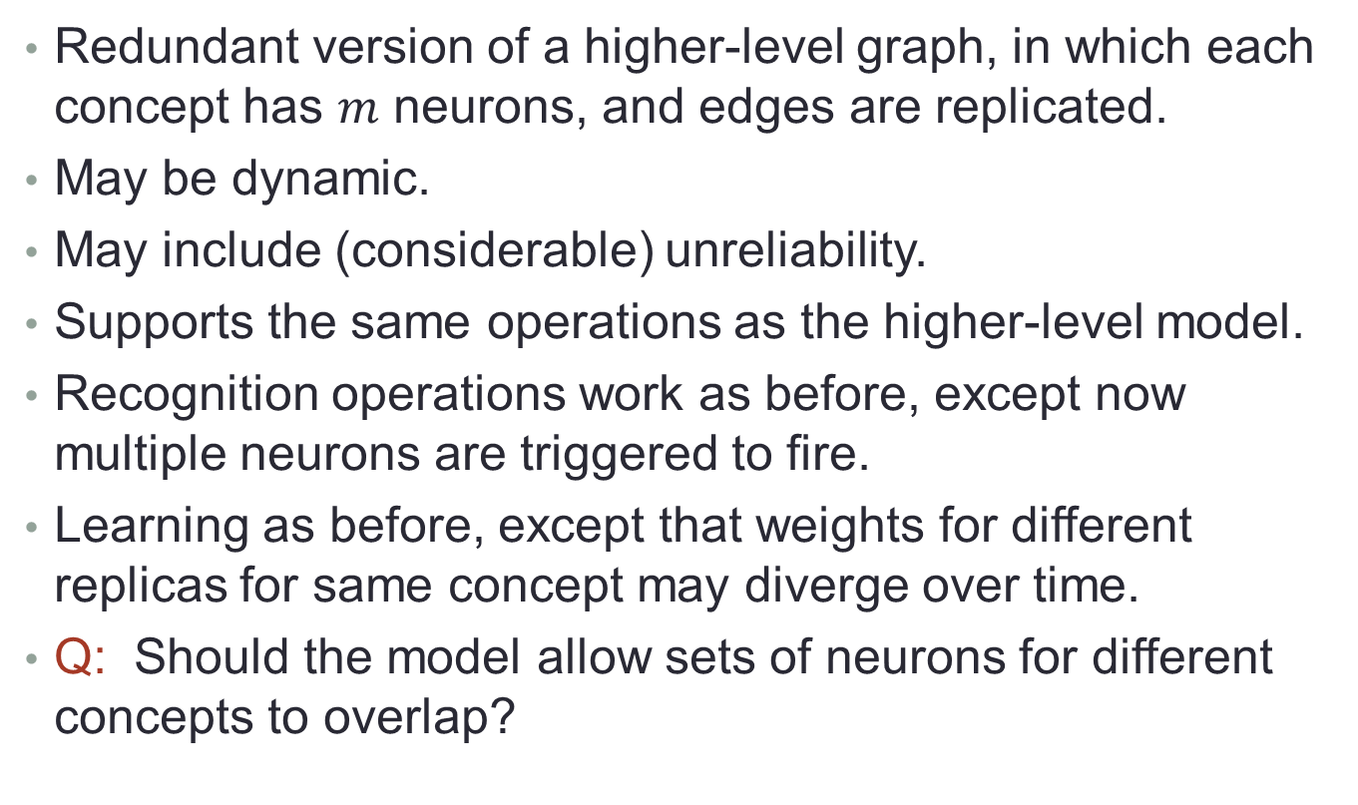
Lower-level IKS model
Redundant version of a higher-level graph, in which each concept has $m$ neurons, and edges are replicated.
May be dynamic.
May include (considerable) unreliability.
Supports the same operations as the higher-level model.
Recognition operations work as before, except now multiple neurons are triggered to fire.
Learning as before, except that weights for different replicas for same concept may diverge over time.
Q: Should the model allow sets of neurons for different concepts to overlap?
Notes:
This is more like Valiant’s work.
------------------------------
Basic representation:
To make things simple here, we assume the same number m of neurons for every concept.
Edges connect every neuron representing one concept c1 to every neuron representing another concept c2 iff the unique reps for c1 and c2 are connected in the higher-level graph.
------------------------------
Dynamic, unreliable,…
As for the higher-level model, this model may be dynamic, and may include some unreliability.
As before, we will want to allow multi-edges and labels, and we will need a neural network model based on this graph model.
--------------------
Operations:
The lower-level model supports the same kinds of operations as the higher-level model.
The direct and indirect recognition operations should work in essentially the same way as before, except that now the inputs will trigger multiple representing neurons to fire, propagation of firing will involve all the replicas, and the final output neurons will receive their potential from multiple internal neurons.
The learning operations will also involve replication, in that the same learning rule will be applied on all the edges that correspond to a single higher-level edge.
However, since the behavior of each individual neuron is stochastic, the behavior of the different replicas for the same concept will tend to diverge as the cascade proceeds.
----------------------------------------------------------------------------
Overlap:
Valiant, and Papadimitriou/Vempala, allow such overlap; PV analyze overlap in detail, in their work on computing with assemblies.
Their simulations show that the set of neurons that represent a particular concept may shift over time, in response to presentations of the concept in relationship with other concepts.
When concepts are presented together, their representations tend toward more overlap.
Alternative hypothesis:
The set of representing neurons for each concept c is fixed (possibly disjoint) and does not change over time.
However, instead of observing the firing of a large set of representing neurons for a concept c that shifts over time, we might be observing the firing of a large set of neurons that participate in a multi-step firing cascade, initiated by the firing of a smaller, fixed set of actual representing neurons for c.
Seems like a matter of definition…
When two concepts are presented together, the connections between them strengthen, because of Hebbian learning.
Then afterwards, presentation of one concept is likely to trigger firing of the rep neurons of the other, as part of a firing cascade.
This might make it look like c has a larger, changing set of representing neurons, whereas actually, it has a smaller, fixed set of neurons, with changing edge weights.

Slide 26
Relationship between the two levels
Low-level model adds redundancy, but otherwise operates similarly to high-level.
Redundancy allows the less-reliable elements of the low-level model to simulate the more-reliable elements of the high-level model.
Should describe a formal simulation mapping from the lower-level model to the higher-level model:
Formal relationships between their states, and between their transitions.
Need simulation mapping designed for probabilistic systems.
High-level
IKS model
Simulation
relation
Low-level
IKS model
Notes:
Once we have formal definitions of both the higher-level and lower-level models, we should describe a formal correspondence between the two system models and use it to prove that the less-reliable lower-level IKS model correctly simulates the more-reliable higher-level model.
The correspondence will define formal relationships between the states of the two system models, and between their transitions.
Since the systems are probabilistic, we would need to consider simulations specifically designed for probabilistic systems, such as the ones studied by Canetti, Cheung, et al. [2], and Lynch and Segala [13].

Slide 27
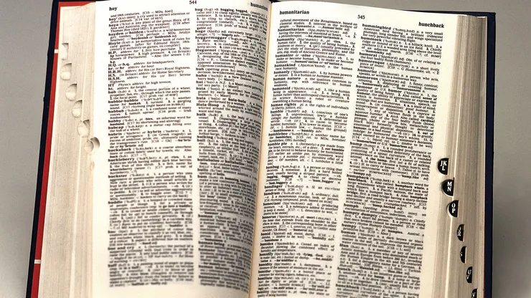
2.2. Lexicon
Stores symbols + associated attributes, supporting fast random access.
Has one (or a small number) of neurons for each symbol.
Input to the Lexicon can come from outside world (vision, listening, reading), or the SKS, or the IKS.
Input from outside world might go through SKS or IKS rather than directly.
Q: Where is the Lexicon stored in the brain?
Neocortex? Large in humans, uniform to support random access.
Notes:
Random access:
Means that the firing of certain external neurons directly triggers the firing of neurons in the Lexicon, with no complex access mechanism involved.
A substantial Lexicon seems to be characteristic of humans, and does not seem to be present in other animals.
----------
Input to Lexicon:
Input encoding a symbol is presented somehow, from outside the Lexicon, and triggers firing of corresponding neurons in the Lexicon.
This input may come from the outside world through vision, listening, or reading; from corresponding symbol neurons in the SKS; or from corresponding informal concept neurons in the IKS.
Perhaps the input from the outside world might not trigger the neurons in the Lexicon directly, but just indirectly, though symbol neurons in the SKS or IKS.
----------
Where in the brain?
In the human brain, I assume the Lexicon could be implemented in the neocortex.
This is consistent with the fact that humans have large and highly developed neocortexes, which could store a large number of symbols.
Also, the neocortex has a fairly uniform structure, which is consistent with the needs of a large random-access store.

Slide 28
2.3. SKS Model
Symbol neurons, directed connections between them.
Neurons and connections should be more reliable than those in the IKS model.
Reliable neurons:
Sharp thresholds (or steep sigmoid functions).
No other failures (or, few other failures).
Reliable connections:
Potential conveyed accurately.
Reliable learning.
As for IKS, consider two levels of abstraction:
High-level
SKS model
Simulation
relation
Low-level
SKS model

Slide 29
Higher-level SKS model
Another dynamic, labeled, weighted digraph.
Nodes = symbol neurons, separate from corresponding symbol neurons in the Lexicon.
Bidirectional edges between symbol neurons in SKS and Lexicon.
Graph is dynamic, changing in response to presentation of new symbols and combinations.
Some unreliability.
SKS can be constructed using operations like those for the IKS (Join/Merge, Associate/Link).
Interesting structures (sequences, parse trees, proofs) can also be built in the SKS, often under purposeful control, using Working Memory.
Notes:
Probably more elaborate, flexible symbolic structures arise.

Slide 30
SKS inputs/outputs
SKS is connected to input mechanisms (visual, auditory) and output mechanisms.
Symbol neuron can be triggered by symbolic inputs, like hearing a word spoken.
Symbol neuron can trigger symbolic outputs, like saying the word.
Reading/writing: Essentially expand the size of the SKS, by utilizing external storage.
SKS is directly connected to the IKS: Each symbol neuron in the SKS connects, rather reliably, to one or more related concept neurons in the IKS.
Notes:
Reading/writing:
Another important input/output mechanism for symbols involves reading and writing.
Reading and writing differ from speech input/output in that they have the pleasant effect of expanding the SKS, increasing its size by utilizing paper or computer storage.
Thus, humans can write down a long list of items, or a complicated math proof, or a very large parse tree.
These symbolic structures can be much larger than what humans can remember, or manipulate, in their internal SKS structures.
----------
SKS connected to IKS:
It seems clear that humans can generally move quickly from a symbol neuron to its corresponding intuitive concept neurons.
The reverse is also usually true, but there are exceptions—when you just can’t think of the name for a concept that you “know”!

Slide 31
Operations on the SKS model
Direct recognition of symbols:
Input symbol presented, in some format.
Causes particular symbol neuron(s) to fire.
Automatic, fast.
Might also trigger symbolic outputs.
Also, firing of symbol neuron in SKS triggers firing of corresponding symbol neuron in the Lexicon.
Example: Hear a word, then say it.
Outputs
Lexicon
SKS
Inputs
Notes:
Direct recognition of symbols:
As for the IKS, when an input is presented for one of the symbols in the SKS, it causes a particular neuron, or neurons, to fire.
As for the IKS, this should happen very fast, in milliseconds.
This might also trigger symbolic outputs.
In addition, the firing of a symbol neuron in the SKS will trigger firing of the corresponding neuron in the Lexicon. As before, this corresponds to recognizing a symbol quickly and directly, and perhaps responding in some automatic way.
As for the IKS, this part of the usage of the SKS corresponds to Kahneman’s fast thinking.
An example here is direct translation, such as hearing a spoken word and outputting a written version.

Slide 32
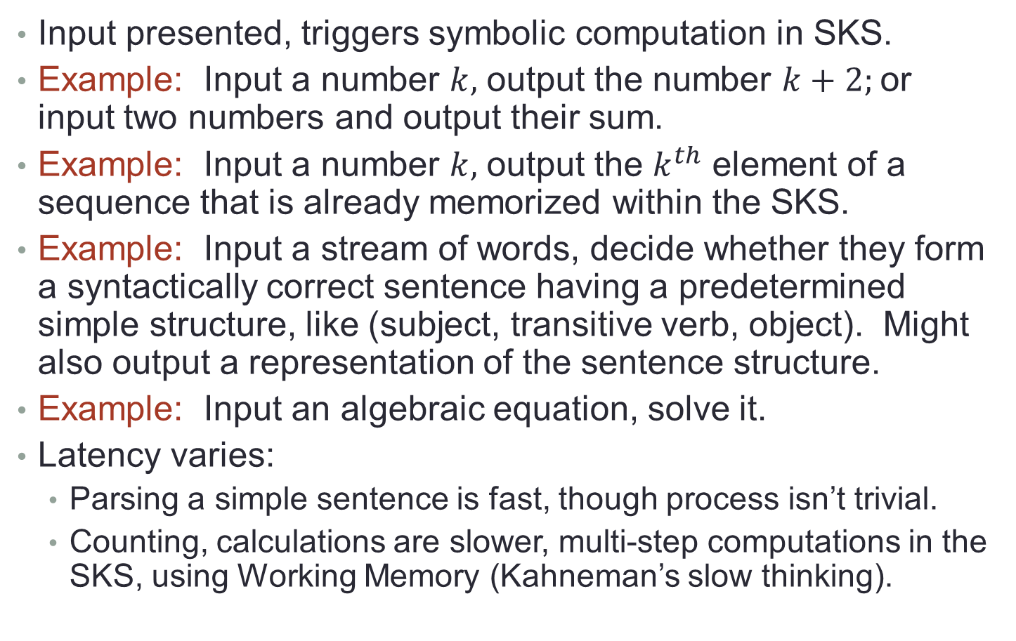
Operations: Multistep symbolic computation
Input presented, triggers symbolic computation in SKS.
Example: Input a number $k,$ output the number $k+2;$or input two numbers and output their sum.
Example: Input a number $k,$ output the $k^{th}$ element of a sequence that is already memorized within the SKS.
Example: Input a stream of words, decide whether they form a syntactically correct sentence having a predetermined simple structure, like (subject, transitive verb, object). Might also output a representation of the sentence structure.
Example: Input an algebraic equation, solve it.
Latency varies:
Parsing a simple sentence is fast, though process isn’t trivial.
Counting, calculations are slower, multi-step computations in the SKS, using Working Memory (Kahneman’s slow thinking).
Notes:
Sentence recognition example:
Input a stream of words, SKS determines whether or not the words form a syntactically correct sentence having a predetermined simple structure, say (subject, transitive verb, object).
The SKS might also output a representation of the sentence structure, such as a parse tree.
More generally, SKS might determine whether the sentence fits any of a predetermined finite set of sentence structures, or fits any correct sentence structure.
Other examples of multistep symbolic computation might include solving algebraic equations.
---------------------------------- Latency:
For recognizing simple sentences, the response should be very fast: people parse simple sentences almost immediately after the input has been fully presented.
But processing even a simple sentence isn’t trivial: it requires finding the words in the SKS and the Lexicon, and fitting them into some representation of the sentence structure, such as a parse tree.
Doing all of this fast might require that the sentence structure be built into the SKS ahead of time, so that what remains to be done is just fitting the arriving words into their proper places.
For more complicated sentences, time is also required for determining the sentence structure.
Counting, or more elaborate arithmetic calculations, will give a slower response, on the order of seconds.
These require multi-step calculations, and following paths in the SKS.
They also require attention, and purposeful focus on particular parts of the computation.
This focus will involve the use of Working Memory (see below), and perhaps some form of WTA.
This type of computation should correspond to Kahneman’s slow thinking.
All of these multi-step computations in the IKS should be precise and reliable, in contrast to multi-step computations in the IKS.

Slide 33
Ops: Computation involving SKS and IKS
Simple case: One-way communication from SKS to IKS
Input symbols are presented, trigger some calculation in SKS.
Firing of some symbol neurons in SKS triggers firing of corresponding concept neurons in IKS.
Triggers a cascade in the IKS, eventual outputs.
Example: Counting in Greek alphabet, leading to letter, leading to virus variant with many connotations.
Two-way interactions
Example: Semantics and intuitive associations for words, in IKS, can help SKS to parse an input sentence.
Lex.
SKS
IKS
Example: Solving a math problem, using intuition to produce solution ideas.
Working Memory
Notes:
The simplest case involves computation in the SKS, followed by triggering of neurons in the IKS and cascades of firing in the IKS. Our examples in Sections 3-5 are all of this type.
More complicated cases would involve more elaborate interactions between the SKS and IKS.
----------
One-way communication from SKS to IKS:
Input is presented, and it triggers some symbolic calculation in the SKS.
The firing of some of the symbol neurons in the SKS triggers the firing of their corresponding concept neurons in the IKS. These, in turn, trigger a cascade of firing in the IKS, eventually resulting in some output.
For example, inputting the number k triggers firing of a symbol neuron for the symbol 7 in the SKS, which in turn can trigger firing of some concept neuron for the number 7.
The IKS then produces a cascade of associations for that concept; for instance, for number 7, we can get the concept of seven deadly sins, seven samurai, seven dwarfs,…
An output might be a mental picture of one of these. The latency for this sort of operation is only a bit more than that for the multistep calculations within the SKS, because the computation in the IKS is fast.
----------
More complicated 2-way interaction:
The semantics and intuitive associations for words, which arise in the IKS, can help the SKS in determining a sensible parse tree for a given input sentence.
Solving a math problem: The problem is input to the IKS, which uses its intuitive reasoning to produce ideas for solving the problem.
These trigger the SKS to perform some formal calculations, producing partial results.
These partial results then serve as new inputs to the IKS, which uses them to produce more ideas, and so on.
The latency for such complex operations is the sum of all the computation times in the IKS and SKS during all the phases of the interaction.

Slide 34
Ops: Learning concepts or relationships
Like IKS, SKS supports adding new symbols and modifying edge weights.
Strengthening connections in SKS should be different from IKS: instead of incremental Hebbian rules, might make large increases all-at-once.
Makes sense since changes are purposeful, not emerging gradually as a result of random experiences.
Notes:
Analogously to the IKS, the SKS can be modified by adding new symbol nodes and new connections, and by strengthening existing connections.
Learning a new symbol should be as in the IKS, using some generic process for selecting an unused neuron. Again, this may use a Winner-Take-All mechanism.
However, adding or strengthening connections between neurons should be different in the SKS from in the IKS: instead of using incremental Hebbian rules to strengthen edges, the SKS may make bigger, “all-at-once” increases in weights.
This makes sense in view of the assumption that the changes in the SKS are produced purposefully, triggered by some external stimulus, rather than emerging accidentally as a result of random experiences.
Making larger changes should lead to faster learning than an incremental Hebbian learning process.

Slide 35
Remarks: SKS
Lower-level model:
As for IKS, redundant version based on less-reliable neurons.
Probably don’t want overlapping sets of neurons here, to maintain clear separation between different symbols and avoid confusion.
Lower level simulates higher level.
Differences between processing in SKS and IKS:
Individual elements in SKS may be more reliable than those in IKS, so processing may be generally more reliable.
In IKS, neurons trigger neighboring neurons based on general stochastic firing rules, whereas SKS is subject to more deliberate external control (through Working Memory).
SKS can carry out precise computations, whereas IKS just produces general associations.
Notes:
Lower-level model:
Individual elements of the SKS models should be more reliable than those in the IKS models, which implies that processing should be generally more reliable.
----------
Differences:
In the IKS, when neurons fire, they trigger neighboring neurons to fire, according to general stochastic firing rules.
On the other hand, the SKS is subject to more external control, which chooses which symbols to focus on and guides the computation step-by-step.
An external mechanism probably helps in keeping track of intermediate results of the computation—see Section 2.5 for Working Memory.
Thus, the SKS can carry out precise, systematic computations, such as arithmetic calculations, whereas the IKS just produces general associations.

Slide 36
2.4. Input and Output
Input:
In both SKS and IKS, inputs arrive via input neurons.
SKS: Encode symbols, e.g. binary or unary rep for numbers.
IKS: Encode intuitive concepts, e.g., a unique input neuron (or set of input neurons) for each concept.
Inputs can be visual, auditory, written, olfactory, tactile.
Output:
Outputs are produced by firing of output neurons.
SKS: Symbolic output (drawn, written, spoken, gestured).
IKS: General impressions, emotional response, physical reaction.
SKS
IKS
Notes:
Both the Symbolic and Intuitive Knowledge Structures accept inputs and produce outputs.
---------- Inputs:
In both the SKS and IKS, inputs arrive via special input neurons.
For the SKS, these inputs encode symbols, and for the IKS, they encode intuitive concepts.
The encoding scheme may depend on the type of input.
For example, number inputs to the SKS could be input in unary or binary.
For the IKS, we could have a unique input neuron for each intuitive concept, or a set of neurons (possibly with overlap between the sets for different concepts), or even a binary code.
The inputs can be visual, auditory, written, olfactory, or tactile.
Visual input might be provided using a feature vector, as in machine learning.
----------
Outputs:
For the SKS, the outputs take the form of symbolic output, which might be drawn, written, spoken, or gestured.
For the IKS, the outputs may be general impressions, such as an assessment of whether something is good, bad, or terrible, or it could be an emotional response, or motor actions.

Slide 37
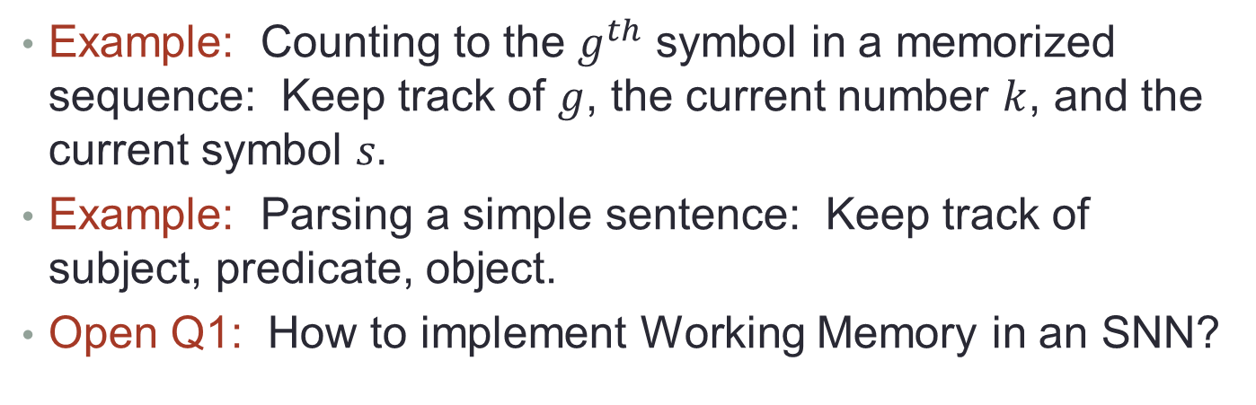
2.5. Working Memory
SKS
Essential for computation in the SKS.
Limited number of neurons used to keep track of intermediate results in an SKS computation.
May represent “roles”, to be filled by specific symbols during computation.
WM
Example: Counting to the $g^{th}$ symbol in a memorized sequence: Keep track of $g$, the current number $k$, and the current symbol $s.$
Example: Parsing a simple sentence: Keep track of subject, predicate, object.
Open Q1: How to implement Working Memory in an SNN?
Notes:
A rudimentary type of Working Memory might also be used with the IKS, allowing the brain to focus attention on some intuitive concept without naming it with a symbol.
The Working Memory contains a limited number of neurons that are used to keep track of intermediate results in an SKS computation.
I think of the Working Memory neurons as representing “roles” in a computation, to be filled by specific numbers, words, or other symbols during computation.
It might be useful to think of them as pointers into the SKS structure.
For example, in a counting process, one Working Memory neuron might keep track of the number k that the system is up to in the count.
If the system is counting symbols in a memorized sequence, another Working Memory neuron might keep track of the current symbol in the sequence.
If the system is counting up to some goal number g (for example, because it is counting up to the gth element in a memorized sequence), then a third Working Memory neuron might indicate the goal.
For parsing a simple sentence, the Working Memory might keep track of the subject, predicate, and object in the sentence.

Slide 38
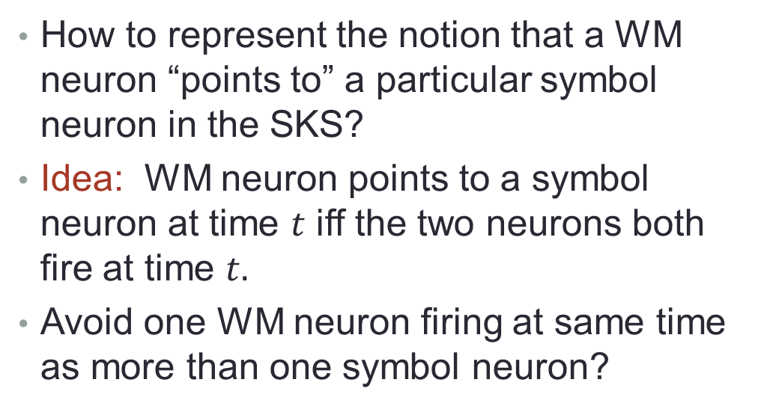
Implementing Working Memory
How to represent the notion that a WM neuron “points to” a particular symbol neuron in the SKS?
Idea: WM neuron points to a symbol neuron at time $t$ iff the two neurons both fire at time $t.$
Avoid one WM neuron firing at same time as more than one symbol neuron?
SKS
WM
Q: How to model two WM neurons, each pointing to its own symbol neuron? Use an alternation pattern?
Q: How exactly does synchronized firing help in performing actual computations in the SKS?
Notes:
An important question is exactly how we should implement the Working Memory in a Spiking Neural Network model, specifically, how to represent the idea that a “role neuron” in Working Memory “points to” a particular symbol neuron in the SKS.
We can’t actually store a pointer in a neuron, as we do in a programming system, so we need to emulate this connection somehow.
One idea is to say that a role neuron points to a symbol neuron at a certain time t if and only if the two neurons both fire at that same time t.
We might interpret this as meaning that the Working Memory is paying attention to, or focusing on, a particular symbol, at time t.
In this case, we might say that the role neuron is “bound to” its current corresponding symbol neuron.
We might strengthen this condition by requiring that the role neuron and symbol neuron fire together for some number of consecutive times.
Perhaps other conditions will need to be added.
But this has an obvious problem: the same role neuron can fire together with two (or more) symbol neurons.
So according to this definition, that would mean that one role neuron is pointing to more than one neuron at the same time.
This does not seem too sensible if the binding between role neurons and symbol neurons is supposed to represent focus.
One way out might be to have the system maintain an invariant that prohibits such “split attention”. Implementing such an invariant might require a Winner-Take-All mechanism.
Other technical issues arise, for example:
• Suppose that we have two role neurons, each pointing to its own symbol neuron.
In that case, we could allow all four neurons to fire together, but this seems confusing.
It might be cleaner to separate the firing for the different bindings, for example, alternating the firing of the two pairs of neurons according to some simple pattern.
• What about two role neurons that point to the same symbol neuron?
In that case, we could allow all three neurons to fire together.
But again, an alternation discipline would probably be cleaner here: at some times, one role neuron fires along with the symbol neuron, and at other times, the other role neuron fires along with the same symbol neuron.
Just having a role neuron and a symbol neuron firing together, in some pattern, doesn’t give us very much.
We have to understand how this synchronized firing helps in performing computation in the SKS, for example, in counting. Some preliminary thoughts about this appear in Section 4. For now, we leave this as:
Open question 1: Devise a concrete SNN mechanism for implementing a Working Memory, based on synchronizing role neurons and symbol neurons. Give specific examples of how this mechanism can be used in symbolic reasoning.

Slide 39
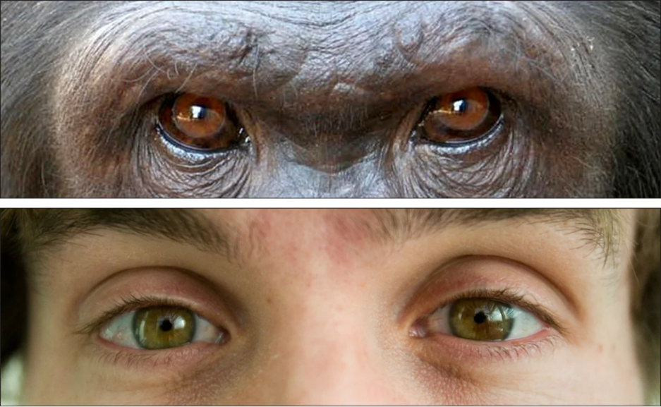
2.6. Humans vs. other primates
Humans and other primates have similar IKS structure and capabilities.
Animals have only a small, rudimentary SKS, if any, and a small Lexicon.
Some advanced apes have significant symbol-processing ability, indicating the beginnings of a human capability.
Can we match the theoretical IKS and SKS structures with actual human brain areas?
Relate to Friederici’s evidence of strong connections between certain brain areas involved in language processing, in adult humans?
Notes:
Considering two knowledge structures, intuitive and symbolic, may help us to understand differences in thinking between humans and other animals.
Non-human primates and other mammals have very well developed intuitive knowledge structures, in some ways better than humans’ structures, at least for the types of concepts that are important for the animals’ survival and comfort.
I imagine that this structure is very similar to intuitive knowledge structure in humans.
Thus, like a human’s IKS, an animal’s IKS is a labeled, weighted, directed multigraph, with unreliable nodes and edges.
It connects to visual, auditory, and olfactory input neurons, and decision, emotion, and motor action output neurons.
It receives input signals, which trigger a cascade of firings, which eventually trigger output behavior.
It also supports learning, in that inputs can cause modifications to this structure, using Hebbian-style rules.
However, I believe that animals have only a small, rudimentary symbolic knowledge structure (SKS), if any.
Some animals (the most advanced apes) seem to be able to acquire a small vocabulary of symbols and use them in simple ways.
These should be able to fit into a small Lexicon, and might be processed in simple ways using a rudimentary SKS.
We might say that animals that exhibit some basic ability to use symbols have a limited form of this fundamentally human characteristic.
I don’t consider that to be a contradiction, only an indication of the beginnings of a human capability in some higher primates.
----------
Match with actual brain areas?
Can we match the theoretical IKS and SKS structures with actual areas of the human brain?
For example, can we map the SKS to some part of the left brain and the IKS to some part of the right brain?
Also, Friederici says that certain connections between brain areas involved in language processing are much stronger in adult humans than in animals (or infant humans). Can we match these real connections with theoretical connections between the SKS and IKS?

Slide 40
Language processing
Relate SKS/IKS dichotomy to language processing?
Regard parse trees representing possible sentence structures as SKSs.
Can be built-in (learning or evolution).
Hearing a sentence involves matching words with leaves in the parse tree, larger phrases with internal nodes in the tree.
Uses Working Memory.
May also use semantic knowledge from the IKS.
Thus, parsing is a special case of symbolic computation in SKS (possibly with help from IKS).
Notes:
What is the relationship between the SKS/IKS dichotomy and language processing?
I think it is natural to regard a parse tree, and more generally, the collection of parse trees representing the possible structures of sentences in a language, as a symbolic knowledge structure.
Let’s assume for now that this collection of possible parse trees is already memorized in the SKS, and not worry now about how it got there, whether by learning or evolution.
Then what happens when a person hears (or reads) a sentence?
They match up the words of the sentence with leaves in the parse trees in the SKS, and larger parts of the sentence with internal nodes in the parse trees.
Somehow, this happens quickly, at least for sentences with simple structure (such as (noun, transitive verb, noun) sentences).
The process of parsing a simple sentence may use WM to describe the “roles” of the major parts of the sentence, such as subject, predicate, and object.
It may also use semantic knowledge from the IKS, to help in disambiguating the sentence.
Viewed in this way, the problem of parsing a sentence is a special case of symbolic computation in the SKS, possibly with some contribution from intuitive processing in the IKS.

Slide 41

Difference between humans, other primates
Main difference: Humans have a well-developed SKS that can represent and manipulate formal relationships among linguistic symbols.
Contrast with Berwick and Chomsky: Main difference is humans’ ability to build arbitrarily complex hierarchical mental structures, using Merge and recursive rules. However:
Conclusion: Main difference is that humans can do sophisticated symbolic processing, whereas animals cannot.
Merge also applies in IKS, animals can do this.
Applying recursive rules is just a special case of SKS computation.
Anyway, humans can’t construct arbitrarily complex hierarchies.
Notes:
So then, what is the most important difference between human and animal capabilities with respect to language processing?
I believe it is just that humans have a well-developed SKS that is capable of representing and manipulating formal relationships among linguistic symbols.
Berwick and Chomsky’s theory of linguistic processing [1] reaches a different conclusion.
They propose that the key difference is the ability of humans to build arbitrarily complex hierarchical mental structures, such as complex sentences, using Merge operations and recursive grammar rules. I don’t think that can be exactly right:
The Join/Merge operation, as studied, for example, by Valiant, seems to be applicable for intuitive concepts in the IKS, at least as much as for symbols in the SKS. Since the IKS is present in both humans and animals, it is likely that animals can perform simple intuitive Merges. In fact, I suspect that there is little difference between the abilities of humans and higher animals to construct intuitive hierarchies in the IKS.
When we talk about recursive grammar rules, we are talking about sophisticated symbol manipulations, which humans can do and animals cannot. Then we are in the realm of symbolic reasoning, which involves the SKS.
I don’t think that humans can construct arbitrarily complex hierarchies in their SKSs.
For instance, it seems to me that a human can keep track of only three or four levels of structural depth in a sentence’s
parse tree.
The human SKS probably has some limitations, which impose limits on the size and depth of the linguistic structures that can be represented.
Also, perhaps understanding a sentence with very complex structure requires focusing on a large number of symbols at once—more than can be handled in WM.
(Of course, if we expand the SKS and Working Memory by writing things down on paper, as humans can do, then much more complex hierarchies could be represented. But this is not a fair comparison—let’s stick to the internal capabilities of the brain.)
At any rate, it seems to me that the important distinction in linguistic abilities is simply that humans can do sophisticated symbolic processing, whereas animals cannot.

Slide 42
3. Example 1: Sequences
SKS: A memorized finite sequence of symbols.
Can compute the symbol that appears in a particular numbered position in the sequence.
Follow this with further computations in the IKS, leading to some output.
Outputs
Lexicon
SKS
IKS
Inputs
Working Memory
Notes:
A simplified, special case of an SKS, namely, a memorized finite sequence of distinct symbols.
Using this SKS, one might compute, for example, the symbol that appears in a particular position in the sequence.
Following this computation with further computation using an IKS might produce some reactions related to a concept denoted by this symbol.

Slide 43
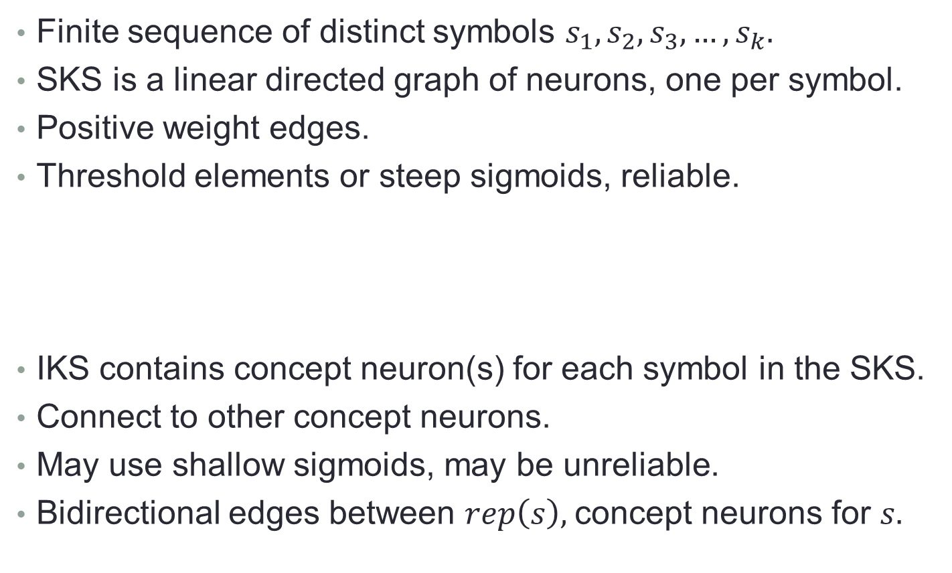
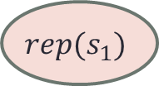
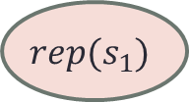


3.1. Representation
Finite sequence of distinct symbols $s_{1},s_{2},s_{3},…,s_{k}.$
SKS is a linear directed graph of neurons, one per symbol.
Positive weight edges.
Threshold elements or steep sigmoids, reliable.
IKS contains concept neuron(s) for each symbol in the SKS.
Connect to other concept neurons.
May use shallow sigmoids, may be unreliable.
Bidirectional edges between $rep\left(s\right),$concept neurons for $s.$
$$rep(s_{1})$$
$$rep(s_{1})$$
$$rep(s_{1})$$
$$rep(s_{1})$$
Notes:
Let’s consider a finite sequence of k distinct symbols, s1, s2, ..., sk.
Let S denote the set of symbols in the sequence.
----------
SKS:
We assume that the SKS is a linear directed graph, with nodes (= neurons) corresponding to the k symbols.
Denote the node for symbol s by rep(s).
These nodes are connected in increasing sequential order, where each rep(si) has a directed edge to rep(si+1).
In addition, each rep node has a self-loop.
Weights on all these edges are positive, so that firing of one rep node at one time t encourages the firing of the next rep node in the sequence, and also encourages its own firing, at time t+1.
We assume that the nodes are threshold elements or have their firing determined by very steep sigmoids, and all components behave reliably.
----------
IKS:
The IKS contains one or more intuitive concept neurons for each symbol in the SKS.
These connect to other concepts using positive weight edges, in arbitrary ways.
Concept neurons for the successive elements of S are not connected to each other in a systematic pattern.
The neurons may use shallow sigmoids, and the components need not behave completely reliably.
----------
Edges between SKS and IKS:
For each symbol s ∈ S, we also have directed edges between rep(s) and each intuitive concept neuron for s, in both directions. .

Slide 44

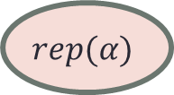

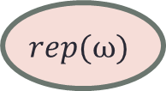
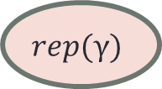

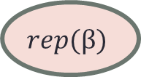
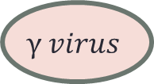
Example: Greek alphabet and virus variants
Each Greek letter can be associated with intuitive concepts, e.g., virus variants.
Each associated intuitive concept has an intuitive concept node in the IKS.
$$rep(α)$$
$$rep(β)$$
$$rep(γ)$$
$$rep(ω)$$
$$α virus$$
$$β virus$$
$$γ virus$$
$$ω virus$$
Outputs
Notes:
We consider the sequence of 24 Greek letters, alpha, beta, ..., omega.
This can be memorized in the SKS, in the manner just described.
Each Greek letter is associated with numerous intuitive concepts, including mathematical notions, hurricanes, and most importantly for this paper, a variant of a certain aggressive virus.
Each of these intuitive concepts has a corresponding intuitive concept node in the IKS.
For this paper, we pretend that every Greek letter has exactly one associated virus variant.
Loosely associated with a virus variant are many of its properties, including where it originated, how contagious it was, how serious an impact it had, approximately how many people caught it, whether it caused widespread business and school shut-downs, whether a lot of people died, etc.
This is all informal understanding, and is represented by nodes and edges in the IKS.
These thoughts are all produced quickly, along the lines of Kahneman’s fast thinking.
----------
Outputs:
In order to define abstract problems involving Greek letters and virus variants, we also include special output neurons in the IKS.
These can represent informal decisions about the virus variant, such as whether the variant was OK, bad, or terrible.
They can also represent emotional reactions, such as neutral, scary, or terrifying.

Slide 45
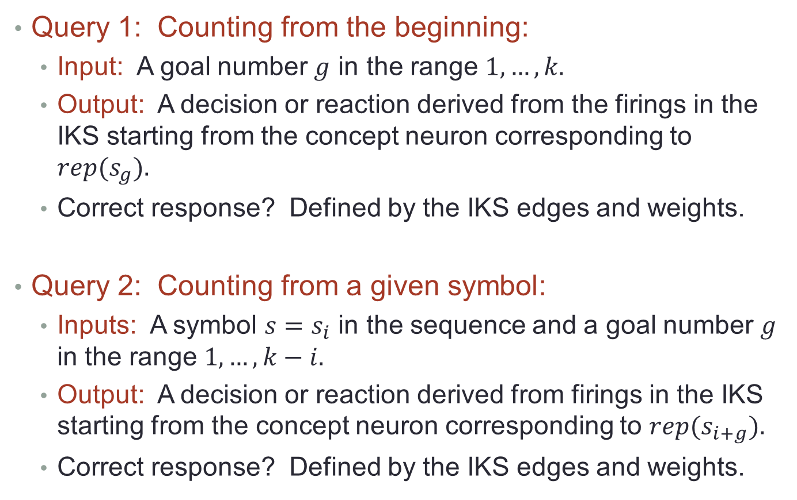
3.2. Example queries
Query 1: Counting from the beginning:
Input: A goal number $g$ in the range $1,…,k.$
Output: A decision or reaction derived from the firings in the IKS starting from the concept neuron corresponding to $rep(s_{g}).$
Correct response? Defined by the IKS edges and weights.
Query 2: Counting from a given symbol:
Inputs: A symbol $s=s_{i}$ in the sequence and a goal number $g$ in the range $1,…,k−i.$
Output: A decision or reaction derived from firings in the IKS starting from the concept neuron corresponding to $rep(s_{i+g}).$
Correct response? Defined by the IKS edges and weights.
Notes:
We define two natural queries for sequences, both of which involve counting symbols and evaluating associated intuitive concepts.
Answering them will involve a combination of symbolic and intuitive reasoning.
For these queries, we assume that each symbol neuron has exactly one corresponding intuitive concept neuron.
----------
Query 1:
The input is a “goal number” g in the allowed range 1, ..., k, where k is the length of the sequence.
The output should be a decision, or emotional reaction, derived from the firings in the IKS starting from rep(s_g ).
The “correct” response for this query is defined by the structure—edges and weights—of the relevant part of the IKS, which can be arbitrary.
According to the IKS execution rules, when the concept neuron rep(sg ) fires, it triggers a cascade of firing of other IKS neurons. This yields a probability distribution on decision neurons, or emotional reaction neurons, that are reached by the cascade, by any particular time. We require that the output for the query follow this distribution.
In the most interesting case, the IKS operation guarantees that, for some time t, with very high probability, the decision or emotional reaction is unique (one neuron), and moreover, that the firing pattern for decision/emotion neurons persists from time t onward.
In this case, the query response should also stabilize to a unique value by some time t, with high probability.
----------
Query 2:
Now there are two inputs, a symbol s in the set S and a goal number g in the range {1, ..., k − i}, where s = si.
The output should be the correct decision or emotional reaction, derived from the firings in the IKS starting from rep(s(i+g) ). The correct response for this query is defined as in the first query, based on IKS behavior starting from rep(s(i+g) ).

Slide 46
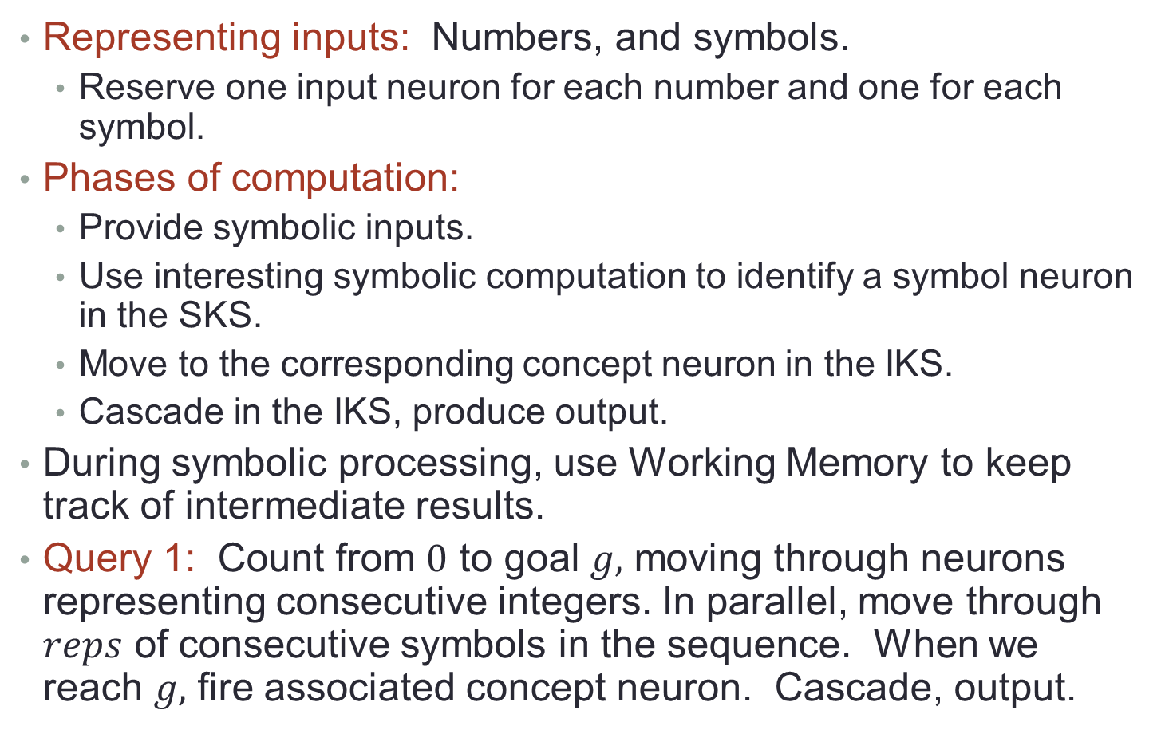
Answering the queries
Representing inputs: Numbers, and symbols.
Reserve one input neuron for each number and one for each symbol.
Phases of computation:
Provide symbolic inputs.
Use interesting symbolic computation to identify a symbol neuron in the SKS.
Move to the corresponding concept neuron in the IKS.
Cascade in the IKS, produce output.
During symbolic processing, use Working Memory to keep track of intermediate results.
Query 1: Count from $0$ to goal $g,$ moving through neurons representing consecutive integers. In parallel, move through $reps$ of consecutive symbols in the sequence. When we reach $g,$ fire associated concept neuron. Cascade, output.
Notes:
Inputs:
The first issue that must be addressed, for processing queries like these, is the representation of their inputs.
Here, how does one input a number in {1, ..., k}?
How does one input a symbol s?
For now, we consider the simplest possibilities: • For numbers in {1, ..., k}, use unary representation. Assume a dedicated input neuron for each number in this range, which is triggered to fire by some external stimulus. • For symbols in S, allocate one input neuron for each symbol.
----------
Phases of computation:
The processing of these two queries can be broken down into sequential phases: provide symbolic inputs, use symbolic computation to identify a particular symbol neuron in the SKS, move to the corresponding intuitive concept neuron in the IKS, and then let the cascade in the IKS produce the final result.
One could also consider queries whose processing involves more elaborate interactions between the two structures; examples of this sort might arise, for example, in parsing and understanding sentences.
But for Queries 1 and 2, one-way communication pattern from the SKS to the IKS is enough.
During the symbolic processing phase of these queries, use WM to keep track of particular symbols that the computation is currently focusing on.
----------
Query 1 processing:
Count up to the input goal number g, moving step-by-step through sequence of neurons representing consecutive pos integers.
As we do this, for each step, we also move one step in the sequential SKS.
When we reach the number g, we must recognize that we have reached it, and identify the associated intuitive concept neuron.
The firing of this neuron starts the cascade that eventually produces the output.
Section 4 has more details of how to express this strategy as a formal SNN.

Slide 47
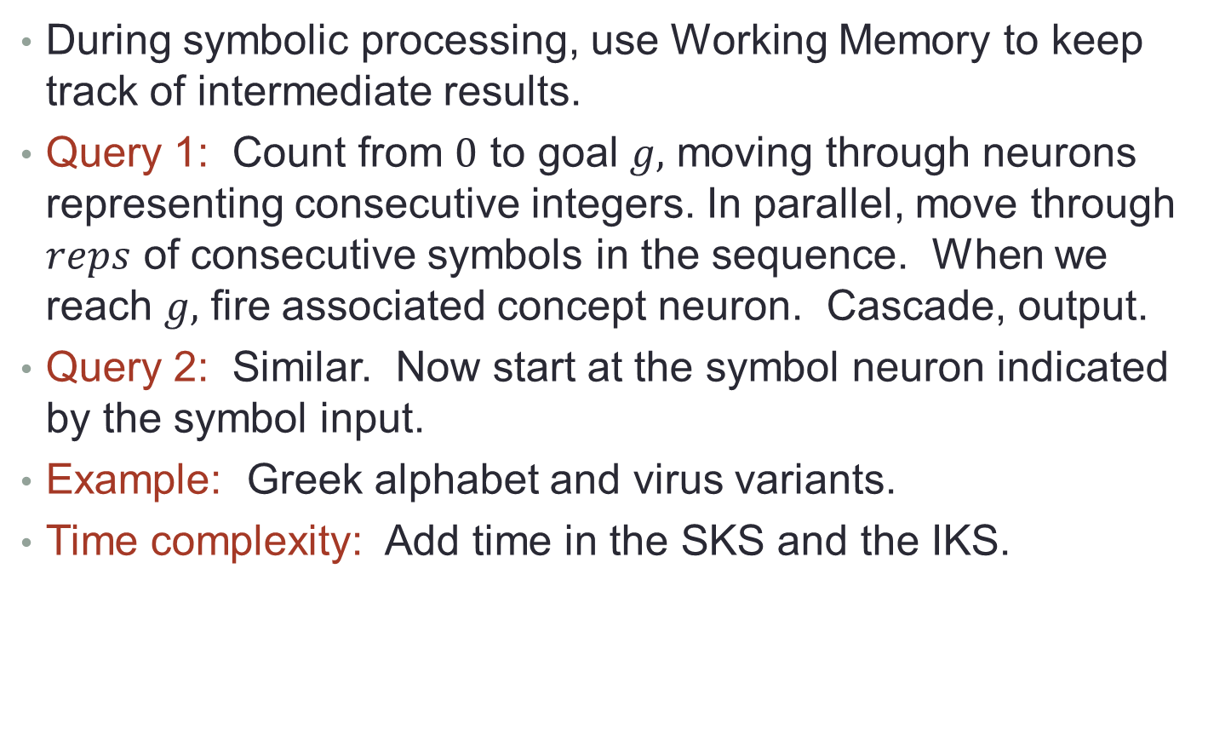
Answering the queries
During symbolic processing, use Working Memory to keep track of intermediate results.
Query 1: Count from $0$ to goal $g,$ moving through neurons representing consecutive integers. In parallel, move through $reps$ of consecutive symbols in the sequence. When we reach $g,$ fire associated concept neuron. Cascade, output.
Query 2: Similar. Now start at the symbol neuron indicated by the symbol input.
Example: Greek alphabet and virus variants.
Time complexity: Add time in the SKS and the IKS.
Notes:
Section 4 has more details of how to express this strategy as a formal SNN.
Query 2 will be answered similarly.
This time, we start at the symbol neuron in the SKS that is indicated by the symbol input.
Again, we traverse the SKS while counting up to the input number g, then continue processing in the IKS. Thus, both of these queries involve simple linear traversals of the SKS, while counting the number of steps that have been traversed.
Example: The Greek alphabet and virus variants:
For Query 1, we have k = 24, so the goal number input is any number g ∈ {1, . . . , 24}.
The output might be an assessment of how bad the virus variant was that was associated with the Greek letter at position g in the Greek alphabet.
For example, input 4 gives the delta variant, which might produce output “terrible” based on the number of cases and deaths.
Similarly, for Q2, we ask how bad the virus variant was that is associated with Greek letter in position g after the variant symbolized by s.
--------------------------------------------------------------
Complexity:
Focus on latency, measured in terms of the number of basic steps in the SNN model. The strategies outlined above involve computation in the SKS followed by computation in the IKS.
In this special case, we can obtain a bound on latency simply by adding the time bounds for these two phases of computation (plus one extra step for the time from when the final symbol neuron fires to when its corresponding intuitive concept neuron fires).
The time for computation in the IKS is the time from when the initial intuitive concept neuron fires until a decision or emotion
neuron fires persistently. This corresponds to the time to follow some number of links in the IKS, plus perhaps some time to suppress all but one candidate decision.
We don’t know the number of links, and it is not clear yet how many candidate decisions there will be, nor exactly how one decision will be selected.
So for now, we encapsulate all this in a parameter, t_iks.
In any case, this should be a small number, qualifying as fast thinking in Kahneman’s sense.
The time for computation in the SKS will be the time to follow g links in the SKS, focusing on one link at a time.
It is not clear how long it will take to follow a single link, so for now, we make this another parameter, tsks.
Then the total time for each of the queries would be roughly gtsks + tiks + 1.

Slide 48
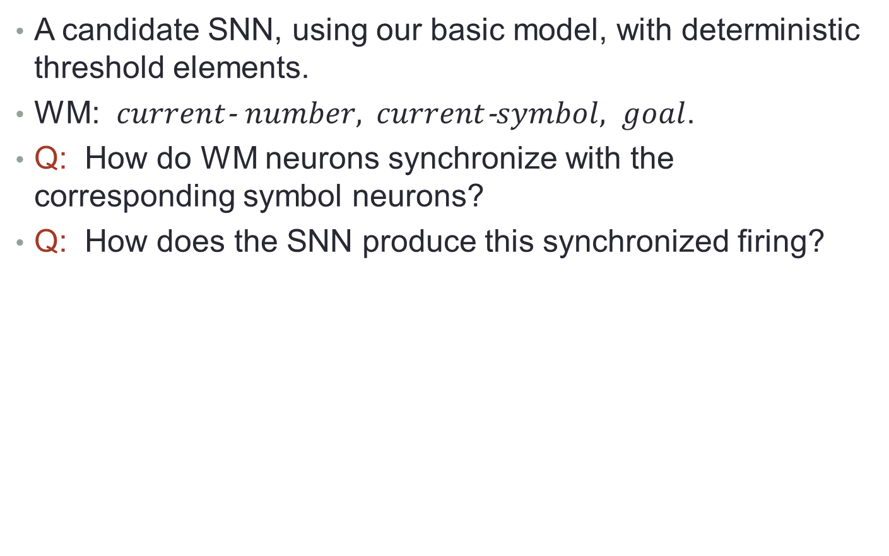
4. More Details
A candidate SNN, using our basic model, with deterministic threshold elements.
WM: $current$- $number,$ $current$-$symbol, goal$.
Q: How do WM neurons synchronize with the corresponding symbol neurons?
Q: How does the SNN produce this synchronized firing?
Outputs
Lexicon
SKS
IKS
Inputs
Working Memory
Notes:
We need a mechanism for counting up to the gth symbol in the memorized sequence.
I assume that Working Memory includes: a current-number neuron that keeps track of a natural number k representing where we are up to in the count, a current-symbol neuron that keeps track of the corresponding symbol in the sequence, and a goal neuron that holds the goal number g.
These neurons represent three distinct “roles”, which will, during the computation, synchronize with particular symbol neurons that fill these roles.
----------
Synchronizing WM and symbol neurons:
Basically the role neuron and a corresponding symbol neuron fire together, though questions remain about exactly what synchronization conditions they satisfy.
Another issue is how the system produces this synchronized firing.
This may require that the graph contain directed edges in both directions, between the role neuron and all the possible symbol neurons in the SKS that might potentially fill this role.
These edges can contribute potential between the two neurons so that once they are both firing, they can help each other to continue firing.
In the rest of this section, I elaborate on some issues involved in answering the queries.
Section 4.1 describes the core of the implementation: a mechanism for incrementing the count by 1 while moving one step in the sequence of symbols. Section 4.2 describes how to start and end the counting process.
Section 4.3 discusses how to tie it all together to answer the queries.

Slide 49

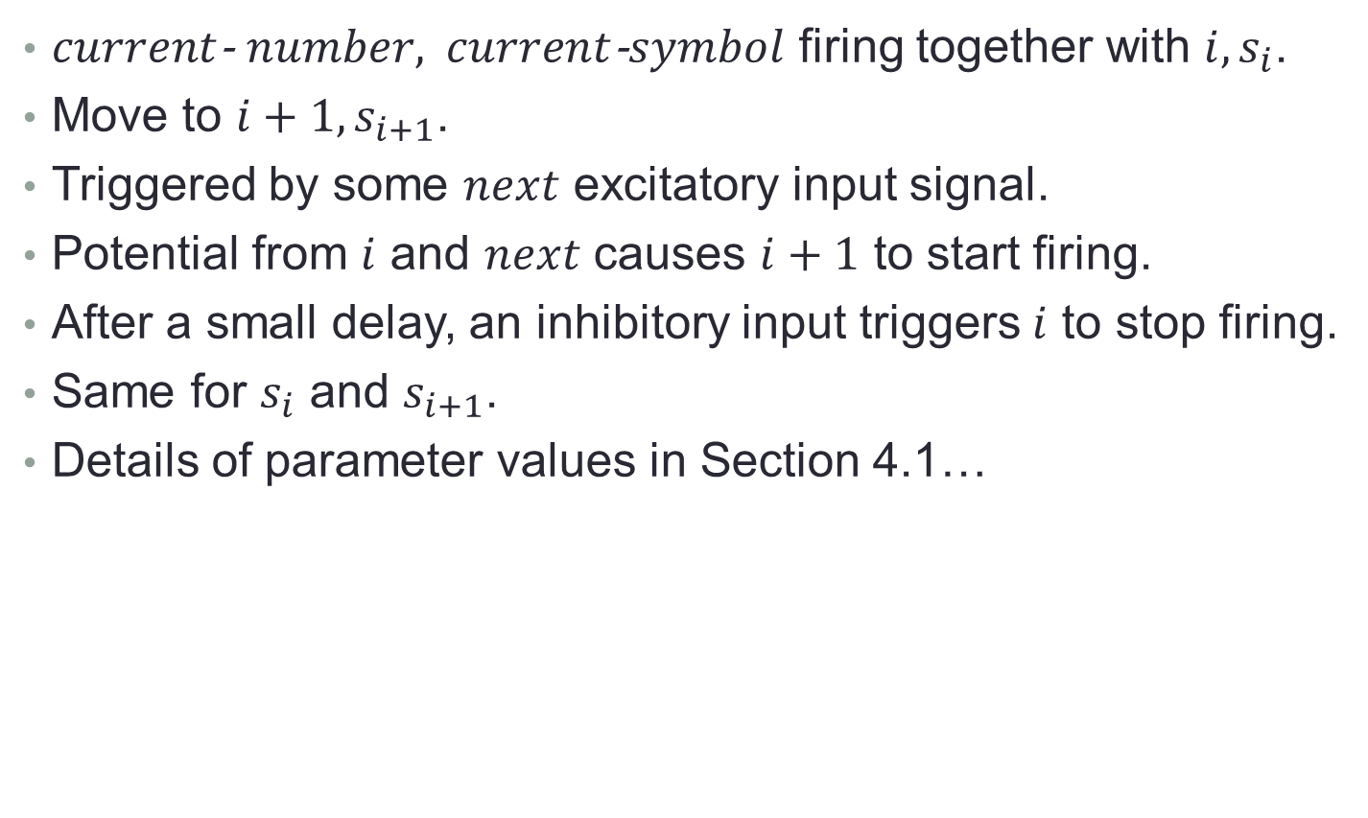
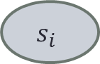
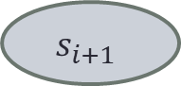
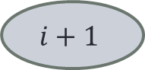
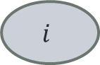

4.1. Incrementing the count
$current$- $number,$ $current$-$symbol$ firing together with $i, s_{i}$.
Move to $i+1, s_{i+1}$.
Triggered by some $next$ excitatory input signal.
Potential from $i$ and $next$ causes $i+1$ to start firing.
After a small delay, an inhibitory input triggers $i$ to stop firing.
Same for $s_{i}$ and $s_{i+1}$.
Details of parameter values in Section 4.1…
$$current−number$$
$$i$$
$$i+1$$
$$current−symbol$$
$$s_{i}$$
$$s_{i+1}$$
Notes:
Details:
Consider any fixed i ∈ {1, . . . , k − 1}.
The increment operation starts with the current-number neuron in the Working Memory bound to neuron rep(i), and the current-letter neuron in the Working Memory bound to neuron rep(si). Specifically, we start with the current-number and current-letter neurons firing, along with the symbol neurons rep(i) and rep(si).
The result should be that the current-number neuron gets bound to rep(i + 1), and the current-letter neuron gets bound to rep(s(i+1)).
That is, we should end with current-number and current-letter neurons firing, along with symbol neurons rep(i + 1) and rep(s(i+1)).
We assume that the increment is triggered by some special next input signal, produced by the firing of a special input neuron.

Slide 50
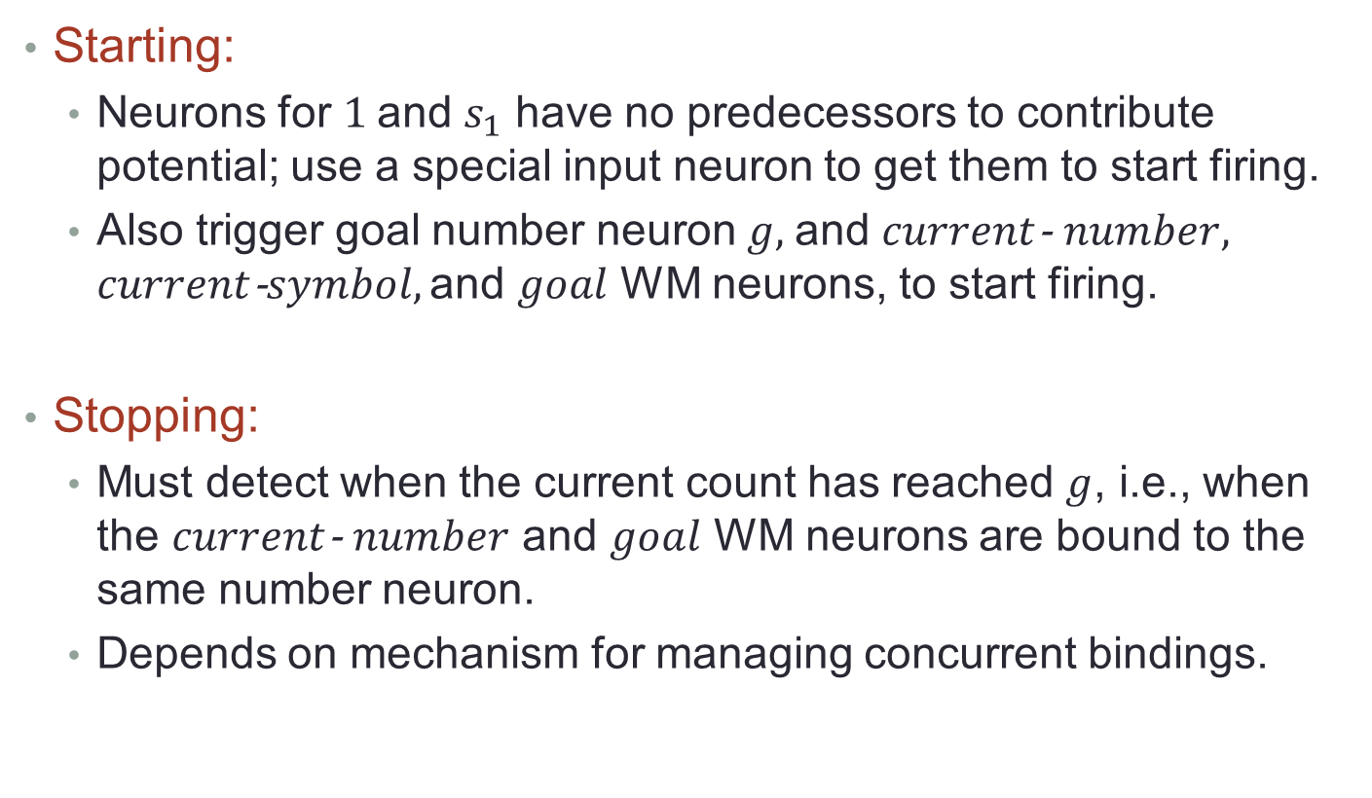
4.2. Starting and stopping the count
Starting:
Neurons for $1$and $s_{1}$ have no predecessors to contribute potential; use a special input neuron to get them to start firing.
Also trigger goal number neuron $g,$ and $current$- $number,$ $current$-$symbol,\text{and} goal$ WM neurons, to start firing.
Stopping:
Must detect when the current count has reached $g$, i.e., when the $current$- $number$ and $goal$ WM neurons are bound to the same number neuron.
Depends on mechanism for managing concurrent bindings.
Notes:
Query 1:
Starting:
We need a way of triggering the firing of the first number neuron, rep(1), and the first letter neuron, rep(s1).
Since these neurons have no incoming potential from predecessor neurons, we will use a special input to get them firing.
Namely, we assume an external excitatory neuron, with edges to both the current-number and current-letter WM neurons, with sufficiently high weight to meet their thresholds.
The external neuron also has edges to the number neuron rep(1) and the letter neuron rep(s1).
These latter two edges have weight s + exc instead of just exc as in the incrementing mechanism.
The extra s compensates for the fact that neurons rep(1) and rep(s1) don’t receive potential contributions of s from their predecessors.
We also must set the goal to a particular desired goal number g.
For this, we use another external input to excite the goal WM neuron to begin firing.
And, we input the goal number g in unary, and thereby trigger the number neuron rep(g) to fire.
But now we have a danger of confusion involving the number neurons. Namely, after these initializations, both the current-number and goal WM neurons are firing, together with their corresponding number neurons. So there is a danger of confusion between the goal number and the current number.
Disambiguating this probably involves a synchronization protocol, such as alternating the firing activities for the two WM neurons.
---------- Stopping:
The mechanism must also recognize when the current count has reached the goal number g.
This requires an equality-detection mechanism to recognize that the goal and current-number WM neurons are bound to the same number neuron.
The design of such a mechanism would depend on our synchronization protocol for different bindings.
For example, if we are simply alternating the firings of the two pairs of neurons, then the mechanism would have to recognize when the same number neuron fired at two consecutive times.
This might be implemented by maintaining some firing history in the state of each number neuron, or in special neurons as in [5].
When the count is finished, we might also want to stop the firing of the current-number neuron.
For this, we should use some inhibitory input.
This remains to be worked out.
----------
Query 2:
Starting the count is slightly different, in that an external input is used to trigger the firing of the starting letter neuron.
Starting the current-number neuron, and ending the count, are as before.
Stopping is as before.

Slide 51
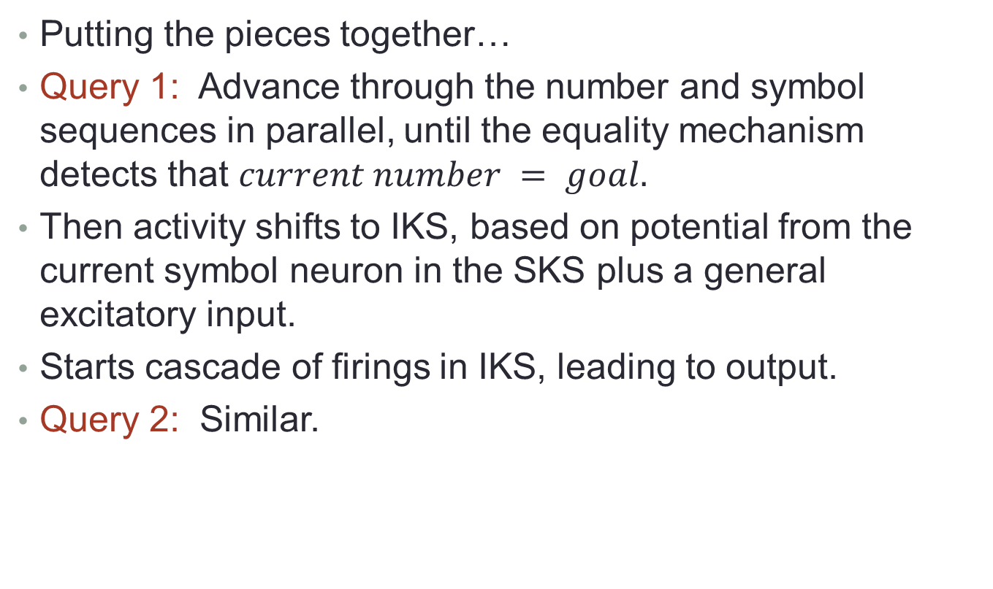
4.3. Answering the queries
Putting the pieces together…
Query 1: Advance through the number and symbol sequences in parallel, until the equality mechanism detects that $current number = goal.$
Then activity shifts to IKS, based on potential from the current symbol neuron in the SKS plus a general excitatory input.
Starts cascade of firings in IKS, leading to output.
Query 2: Similar.
Notes:
The complete solution to Query 1 involves advancing through the number and letter sequences in parallel, until the equality mechanism detects that the current-number neuron and the goal neuron bind to the same number neuron. At that point, computational activity shifts to the IKS: another external excitatory input signal gets sent to all the intuitive concept neurons in the IKS that correspond to letter neurons in the SKS.
The unique currently-firing letter neuron in SKS also contributes potential to its corresponding intuitive concept neuron in IKS.
Based on a combination of these two types of potential, the correct intuitive concept neuron for the chosen letter starts firing.
Once the correct intuitive concept neuron starts firing, it causes a cascade of firings in the IKS, which yields a probability distribution of decision neurons, or emotional reaction neurons, that are reached by the cascade.
Under plausible assumptions about the IKS, with high probability, this soon leads (within some time tiks) to a unique, persistent decision.
Analyzing this probability will require a more detailed model of how the firing cascades operate in the IKS.
The overall latency for answering the query will be approximately gd + tiks, for some constant d, where we are allowing d steps to account for each increment of current-number.
Processing for Query 2 is similar, LTTR.
The difference is in the initialization of current-number.

Slide 52
5. Example 2: Simple Parse Trees
SKS: A small, simple parse tree, with unordered children.
Parse tree is not memorized in the SKS ahead of time---words arrive linearly and tree gets constructed.
Conjecture: Structure of simple sentences, like (subject, predicate, object), is built-in ahead of time (evolution? learning?); what remains is identifying which built-in structure to use, and filling in the terminals.
A simplified rep of the tree gets passed to the IKS, which associates intuitive meaning and creates a picture.
Lex
SKS
IKS
WM
Notes:
The second example of a symbolic knowledge structure is a parse tree for a sentence.
A parse tree, as studied in linguistics, consists of nonterminals at the internal nodes of a tree and terminals at the leaves.
Parse trees are generally constructed based on context-free grammar rules.
Since these rules are recursive, this allows for the construction of arbitrarily large and complex parse trees. However, sentences that are normally encountered in practice are not very large or complex, so their parse trees are rather small.
Here I consider a variant of the usual parse trees, in which the children of every node in the tree are unordered.
For example, a sentence may consist of a subject noun, predicate verb, and object noun, but the order of these three elements is not significant.
In different languages, these three elements might be presented, orally or in writing, in different orders—say, (subject, pred- icate, object) vs. (subject, object, predicate).
But in the SKS representation, it is enough to remember just that the sentence consists of these three parts.
Unlike the sequences in Sections 3 and 4, I do not assume that the parse trees are memorized in the SKS ahead of time.
Rather, the words of a sentence are presented as input (by hearing or reading), and the parse tree gets constructed on-the-fly.
However, I think it is very likely that the general structure of typical parse trees is built into the brain a priori, as a result of evolution or early learning.
For example, for 3-word sentences that consist of just a subject, predicate, and object, there is probably a built-in structure in the SKS that represents this general parse tree structure.
The particular nouns and verb that appear in a particular sentence are not built in, but are filled in during processing of the sentence.
For more complex sentences, more work will be needed during sentence processing to determine the structure of the tree, as well as for filling in the words.
In any case, during sentence processing, an (unordered) parse tree gets constructed in the SKS.
Some simplified representation of this tree then gets passed to the IKS, which associates intuitive meaning with the sentence via cascades of firing, producing as output a kind of “story”, perhaps an active picture.
Here I am drastically simplifying matters, by neglecting the possibility that the IKS helps in constructing the parse tree.
This sort of semantic disambiguation is common in language understanding, but I will restrict attention for now to sentences that can be parsed based only on their syntax.

Slide 53
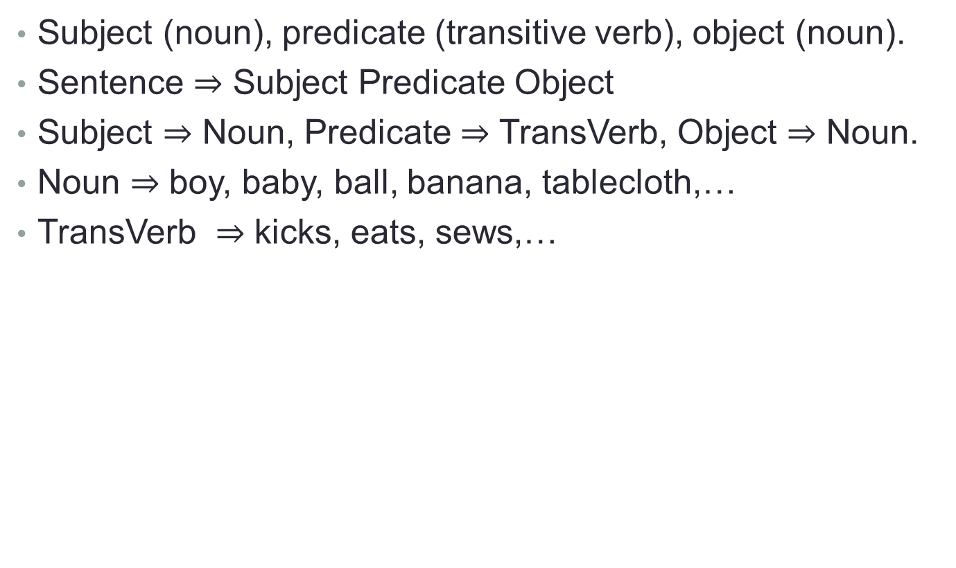
Example: 3-word sentences
Subject (noun), predicate (transitive verb), object (noun).
Sentence $⇒$ Subject Predicate Object
Subject $⇒$ Noun, Predicate $⇒$ TransVerb, Object $⇒$ Noun.
Noun $⇒$ boy, baby, ball, banana, tablecloth,…
TransVerb $⇒$ kicks, eats, sews,…
Sentence
If this parse tree structure is fixed and built into the SKS, parsing amounts to just filling in the terminals.
Subject
Predicate
Object
Noun
TransVerb
Noun
Boy
Kicks
Ball
Notes:
As a special case, I will sometimes consider parse trees with a very simple structure corresponding to 3-word sentences consisting of a subject noun, predicate verb, and object noun. In terms of traditional context-free grammars, the nonterminals are Sentence, Subject, Predicate, Object, Noun, and TransitiveVerb, with Sentence as the starting nonterminal.
The set of terminals is a large collection of already-memorized nouns and transitive verbs.
The formal grammar productions are: • Sentence ⇒ Subject Predicate Object (but recall that the order is not significant, this is an unordered set rather than a sequence). • Subject ⇒ Noun, Predicate ⇒ TransitiveVerb, Object ⇒ Noun. • Noun ⇒ boy, baby, horse, ball, banana, tablecloth,...; Verb ⇒ kicks, eats, sews,...
In this special case, verbs are always present tense.
Example sentences include “Boy kicks ball.”, “Baby eats banana.”, “Horse sews tablecloth.”, etc.
Assuming this general parse tree structure is built into the SKS a priori, what remains to be done during parsing is just filling in the terminals.
For more general cases, I will consider more complicated sentences and parse trees, and also cases where the sentence structure is not known a priori, but must be determined during sentence processing.
In this latter case, additional work will be involved in determining the parse tree structure, in addition to the work of filling in the terminals.

Slide 54
5.1. Representation, computation in SKS
Parse tree representation: A neuron for each node, edges between parents and children.
Terminal, nonterminal symbol neurons also in Lexicon.
Construct the tree in SKS by allocating neurons for the nodes in the parse tree and establishing the needed connections.
Process can be faster if high-level portions of the tree are already represented in the SKS (evolution or prior learning).
More simply, assume that the SKS maintains a collection of standard sentence structures, each with its parse tree shape and nonterminals filled in.
Then we need only choose the structure and fill in the terminals.
Notes:
A parse tree could be represented in the SKS fairly directly, with a neuron representing each node of the tree and edges connecting the neurons that represent parents and children in the tree.
Note that this neural network representation does not specify any ordering for the children of a node, which is fine since we are considering unordered versions of parse trees.
The terminal and nonterminal symbols are also represented by neurons in the Lexicon; for each such symbol that occurs in a parse tree, there are edges back and forth between the Lexicon entry and the neurons in the parse tree that are labeled by that symbol.
The parse tree for an input sentence can be constructed in the SKS by allocating neurons for the nodes in the parse tree and establishing the needed connections.
This may seem like a time-consuming learning process, which is inconsistent with the speed with which humans recognize basic sentences. However, the process can be sped up if the high-level portions of the tree are already represented in the SKS, as a result of evolution or previous learning. This captures the idea that the brain starts the parsing process already having built-in familiarity with standard sentence structures.
I think this is reasonable, and I will assume it from now on.
In fact, to make things as simple as possible, I will assume here that the SKS maintains a collection of standard sentence structures, each with a complete parse tree shape and all of its nonterminals filled in.
Moreover, every sentence that is input will fit one of these standard structures.
So the only things that need to be filled in are the terminals.

Slide 55
Choose structure, fill in terminals
Sentence input sequentially, word-by-word.
SKS starts with all possible sentence structures, narrows down as words arrive, until only one remains.
Example: (Subject, Predicate, Object) vs. (Subject, Predicate), sentences like “Boy eats radish” vs. “Boy eats”.
TBD: Define an SNN data structure for keeping track of possible parse trees, and other partial progress in parsing (match input words to leave of trees, indicate when this is impossible, identify when only one tree remains).
Use Working Memory to help in assigning terminals to leaves.
Conjecture: SKS reps for parse trees are language-independent (and may be built-in), but the method of assigning terminals to leaves is language-specific (and therefore, learned)
TBD: Develop language learning algorithms that work with built-in parse-tree structures..
Notes:
Given our strong assumptions, the parsing process needs to perform only two tasks: (1) determine which standard structure fits the given sentence, and (2) finish the construction of the parse tree by associating specific terminals to the leaves.
----------
Choosing a parse tree:
Since sentences are input word-by-word, it seems plausible that the SKS might start out with a large collection of possible sentence structures, and narrow down the set of possibilities with each new word, until only one possible structure remains.
For each new word that is input, the SKS tries to incorporate the word into its proper place in each of its still-possible parse trees.
If it fails (for example, because the new word is the wrong part of speech for the structure), then the SKS drops the structure from its set of possibilities.
For example, consider two sentence structures: (subject, predicate, object) and (subject, predicate).
Suppose that an English sentence is being presented, and its second word is a verb that can be either transitive or intransitive (such as eats, runs, reads, etc.).
Then after the first two words arrive, both structures are still possible, and the verb can be assigned to a leaf in both of their parse trees.
After that, either the sentence ends, or another noun arrives.
This leads to attempts to match both partial parse trees, but only one succeeds.
It remains to devise a workable SNN-based data structure for keeping track of the set of possibilities.
This should include: a way of representing multiple parse trees in the SKS; a mechanism to incorporate each successive input into each possible parse tree, producing an indicator when this is impossible; and a mechanism to identify when only one parse tree remains in the set of possibilities.
----------
Assigning terminals to parse tree leaves:
During construction of a parse tree, the WM will help in assigning terminals to particular leaves of the tree.
For example, in a simple (Subject, Predicate, Object) sentence, a WM neuron may represent the Subject role, and may bind to a symbol neuron for a particular noun.
This binding should persist long enough to establish the firing patterns needed to incorporate the noun into the SKS representation of the parse tree. The use of WM will be more complicated in more complicated sentences.
Although the SKS representations for parse trees are language-independent, the method of assigning terminals to nodes in the parse trees is language-specific.
For example, consider simple three-word (subject, predicate, object) sentences.
Recall that the parse trees do not specify an order for these three parts of the sentence.
But particular languages will have their own ordering conventions.
For example, in English, the first word in a sentence will generally be the Subject, the second the Predicate, and the third the Object. Other languages may use different conventions.
These language conventions lead to different rules for parsing an input sentence.
In this way, we can have a language-independent internal representation of the sentence structure, with a language-specific way of performing the parse.
----------
More complicated use of WM:
The use of Working Memory will be more complicated in more complicated sentences.
Consider the sentence “The boy who eats the candy pets the duck.”
The phrase “The boy who eats the candy” can be parsed first, with the help of Working Memory neurons.
The result of this parsing is a branch of a parse tree.
But then we want to treat the entire phrase as a unit, to be related to the rest of the sentence.
So a nonterminal symbol node in the SKS that represents this entire phrase can bind to a WM neuron that corresponds to the role “Subject”, and the rest of the parse can proceed.
In fact, the same neurons in Working Memory might be repurposed in different parts of the parse, e.g., a Subject role neuron can bind to a neuron representing the terminal “boy” in parsing the first phrase, and later to a neuron representing the subtree for the entire phrase “The boy who eats the candy”. This all suggests to me that the internal SKS parse tree representations may be built-in, as a result of evolution, whereas particular languages are certainly learned.
It remains to develop particular learning algorithms by which the brain can learn different parsing methods for different languages, all based on the same SKS parse tree structures.

Slide 56
Output of the SKS
Some abbreviated representation of the parse tree for an input sentence:
Q: What might this look like? Small labeled graph of neurons, one for the sentence, one for each terminal, labels for roles?
Sentence
Subject
Object
Predicate
Boy
Kicks
Ball
Notes:
The SKS eventually produces the parse tree for an input sentence.
Actually, it probably doesn’t retain the entire parse tree; for example, the intermediate neurons representing the nonterminals Noun and TransitiveVerb are not necessary once parsing is finished.
So what the SKS produces is a reduced version of the parse tree; for example, for a simple 3-word sentence, the reduced version will probably contain some representation of the sentence as a whole, of the three parts of the sentence, and of the actual nouns and verbs that make up these parts.
This representation might be a small labeled graph of neurons, containing a neuron for the sentence and one for each of its three terminals.
Edges between the sentence neuron and the terminal neurons could be labeled by their roles—subject, predicate, or object.

Slide 57
5.2. Representation, computation in IKS
Firing of SKS reduced parse-tree neurons triggers firing of related IKS neurons, followed by IKS cascades and outputs.
The related IKS neurons comprise an outline for a simple “story”, including actions.
Open Q2: Pin down precise reps for reduced parse trees in the SKS, stories in the IKS. Design mechanism for SKS reduced parse tree to trigger IKS story.
Cascades select for associations relevant to the entire story, not just to individual words.
IKS story rep gets refined, embellished over a short time.
Output: Mental picture (dynamic cartoon?) of the story. Judgment, emotional response.
Notes:
Now what happens to the (reduced) representation of the parse tree that is produced by the SKS?
Basically, the firing of the neurons in this representation, possibly with the help of some external signal, should trigger the firing of some related intuitive concept neurons in the IKS.
Then the IKS firing cascades proceed until they result in some output.
The intuitive concept neurons that are triggered should comprise some type of outline for the “story” that the parsed sentence tells.
This should be a collection of neurons that together represent the individual components and the relationships between them; the precise structure for this outline remains to be determined.
In the case of simple 3-word sentences, we might have one concept neuron that represents the general idea of a “story” plus neurons representing the three concepts that comprise the story, tagged somehow by their roles in the story (as in the SKS representation).
But there may be more to it: a verb might be represented, not by a single concept neuron, but by a collection of neurons that fire according to some timing pattern corresponding to the action denoted by the verb.
“Kicks” would probably be represented by some neurons whose firing corresponds to the action of kicking, including its direction and speed.
Discuss with Brabeeba and Keith; are motifs like the ones they spoke about related to these stories?
Open Q2: Pin down precise reduced representations for parse trees in the SKS, and precise representations for outlines for simple stories in the IKS.
Develop a mechanism by which an SKS representation of a parse tree can trigger the corresponding IKS representation of a story outline.
Once these initial concept neurons are triggered, they start the usual IKS cascade of firing, continuing until some IKS output is produced.
This cascade does not follow just the associations that arise from the individual elements of the sentence/story, but also the combinations of the elements and the relationships between them.
That is, the cascade selects for associations that are relevant to the story.
For example, in the sentence “Boy kicks ball.”, the combination of words is likely to trigger a picture of a boy aged 6-10 running outdoors, kicking a soccer-ball-sized ball, rather than a picture of a baby boy sitting indoors, or a golf ball on a tee.
The sentence “Horse sews tablecloth.” is likely to trigger a cartoon of a horse sitting at a table, but is unlikely to trigger a picture of a racehorse at a racetrack or an elegant lace tablecloth in a dinner setting.
The context provided by the other parts of the story and their relationships influence the associations that arise from each particular part.
Such a cascade pattern should arise naturally in an SNN model because the neurons representing the various parts of a story all contribute potential to other concept neurons.
This potential adds up, thereby encouraging the firing of neurons for concepts that are relevant to the entire story, rather than just the individual parts.
The IKS representation of the story gets refined over a short period of time, as a result of the cascade of IKS neuron firings.
The IKS representation that is triggered directly by the SKS representation, that is, the story outline, is probably rudimentary, and gets embellished over a short time, as more context information gets incorporated.
All of this is still fast thinking, since the actions of the IKS cascade are fast.
What is the final output that is produced by this IKS process?
It should be a mental picture of the activity in the story.
Such a picture might be represented in the IKS using a typical internal form for visual processing in computer vision—an abstract two-dimensional picture that has rudimentary representations of the key components (stick figures, outlines of buildings, etc.).
It can be a kind of cartoon.
The picture will usually be dynamic, since one of its constituents is a verb, indicating an action. As we had for the sequence example, we could have a further IKS output representing the main judgment or emotion that is triggered by the picture, such as “pleasant”, “unpleasant”, or “absurd”.

Slide 58

Communication from SKS to IKS
SKS
IKS
???
Boy
Kicks
Ball
Notes:
Interaction between SKS and IKS:
We have been considering only a special case of sentence understanding in which the SKS performs symbolic processing first, then passes control to the IKS, which produces a picture of the story, and judges whether the story is pleasant, unpleasant, absurd, etc.
This one-way interaction is similar to what happens in our sequence example.
More elaborate parsing examples would incorporate feedback from the IKS to the SKS, for instance, when semantic information is used to resolve ambiguities in the parse structure.

Slide 59
6. Learning the representations
New intuitive concepts (in IKS).
New symbols (in SKS and Lexicon).
Connections between intuitive concepts (in IKS, Hebbian learning).
Connections between symbols (in SKS, involved WTA, Working Memory, can learn in large jumps).
Connections between symbols and their intuitive counterparts (in SKS and IKS, Hebbian learning).
Outputs
Lexicon
SKS
IKS
Inputs
WM
Notes:
New intuitive concepts:
These must get placed somewhere in the IKS. New neuron(s) must be selected to represent them.
This might involve Winner-Take-All
Valiant’s book [15] contains some example protocols based on random graphs.
Lynch and Mallmann-Trenn [7] present others based on identifying the candidate neuron with the highest incoming potential.
---------- New symbols:
These must get placed somewhere in the SKS, and also in the Lexicon.
The method of choosing new representing neurons can be similar to what is used in the IKS.
Also, for each new symbol, connections must be set up in both directions between the neurons in the Lexicon and those in the SKS corresponding to the new symbol.
---------- Connections between intuitive concepts:
Since people (and other animals) can learn to relate any pair of intuitive concepts, the brain must have sufficient physical connections between concept neurons to support this learning.
These connections can be strengthened or weakened based on experiences. Thus, the underlying directed graph in the IKS should also be sufficiently connected.
Edge weights should increase and decrease in response to experiences, according to some version of Hebbian learning.
This learning will probably be gradual because of the noisy nature of learning of intuitive concepts and relationships.
------------ Connections between symbols:
Learning a symbolic structure, such as a sequence or linguistic structure, is different from learning connections between intuitive concepts.
It doesn’t just happen automatically, as a result of experience, but requires attention, is more purposeful, and is controlled by some outside stimulus.
The process should be less noisy than intuitive learning.
Thus, learning in the SKS should also involve attention, in the form of Working Memory.
The learning rule does not need to accommodate much noise, so it can make larger jumps than learning rules in the IKS.
Because activity in the SKS is more purposeful, learning can proceed in more interesting ways than just simple Hebbian rules.
For example, learning a sequence, such as the Greek alphabet, is not just simple Hebbian learning of individual connections between consecutive pairs of symbols. Rather, it may be more like learning a song, taking advantage of some overall structure, such as a rhythmic pattern.
For another example, consider the problem of learning a language, specifically, the sub-problem of learning the language’s conventions for the order of words in a sentence, as described in Section 5.1.
In terms of an SNN model, this means learning a network that will handle sentence inputs correctly for the given language, assigning the successive words to the appropriate positions in a built-in parse tree.
This network might be learned through a supervised learning process, where wrong attempts lead to nonsense sentences and give negative feedback.
----------
Connections between symbols and their intuitive counterparts:
Intuitive concepts may be learned simultaneously with their symbols, or in either order.
In any case, a new symbol is learned (in the SKS and Lexicon), and a new concept is learned (in the IKS).
Repeated simultaneous presentation of the symbol and the concept can lead, via Hebbian learning, to strengthening of weights on the edges connecting them.
Another matter that remains to be considered is how connections can be learned between complex symbolic structures and corresponding complex intuitive structures. In all of these cases, it would be good to describe and analyze specific learning mechanisms.

Slide 60
6. Conclusions
Summary: SKS + IKS, ideas for implementing them in SNNs.
Examples: Counting through a memorized sequence, understanding simple sentences.
Main Open Q’s:
Q1: Binding between WM neurons and symbol neurons.
Q2: Connecting SKS reduced parse trees and IKS “stories”.
Future examples:
More elaborate arithmetic, math proofs.
More elaborate parsing examples.
Richer interactions between SKS and IKS
Lex
SKS
IKS
WM
Notes:
In this paper, I have proposed that two distinct types of structures are present in the brain: Symbolic Knowledge Structures (SKSs), used for formal symbolic reasoning, and Intuitive Knowledge Structures (IKSs), used for drawing informal associations.
I have described many ideas for modeling these structures, and for implementing them in Spiking Neural Networks.
I have developed two basic examples of their use: counting through a memorized sequence of disease variants, and understanding simple sentences with predetermined structure.
This is a collection of ideas for a theory, but not a complete, coherent theory.
I am interested in developing this further, until the whole thing makes sense in terms of a formal model like that in [8].
The approach should be algorithmic, like that used in [9, 7], with formal network descriptions and analysis.
But that will take considerably more thought and work.
Much more remains to be done in pinning down the various individual mechanisms, and expressing them in terms of a single SNN model. In particular, for the WM attention mechanism, we need more details for how the binding between WM neurons and SKS neurons works, especially for how firing is synchronized (Open Q 1).
For the parsing example, we need more details of how a parse tree gets filled in, and how it gets copied from the SKS to the IKS in the form of a story outline (Open Q 2).
Many more examples of symbolic reasoning can be considered, including more interesting arithmetic calculations than just counting, and more elaborate linguistic examples than parsing of sentences with simple, predictable structure. Higher mathematical reasoning such as solving algebraic equations, and even creative construction of mathematical proofs, are also interesting to consider. We can also study examples involving elaborate interactions between SKS and IKS, rather than just simple one-way interactions as in the examples in this paper.

Slide 61

Some thoughts…about plumbing
Consider how a person might understand how a plumbing system works, and how to construct one successfully.
Pipes, sinks, toilets, tubs, washing machines, water flow, drains…
Complex system with many parts, interesting behavior.
Many precise constraints on what is needed to make it work well; e.g., pipes must fit into the walls, need a certain slope for water to flow, need vent pipes to prevent a vacuum,…
Notes:
Discussion based on conversation with my husband Dennis, who is a plumbing hobbyist.
Has built bathrooms.

Slide 62
Some thoughts…about plumbing
Consider how a person might understand how a plumbing system works, and how to construct one successfully
Q: What advantages might the human language system provide in understanding plumbing systems?
Q: Could an ape understand, or build a plumbing system?
Need at least:
1. Sufficient memory space to store all the needed information about plumbing systems. Long-term memory, also working memory.
2. A reliable facility for logical reasoning to figure out precisely how things should work. Involves some math, understanding logical consequences, cause-and-effect, real-world behavior.
3. Ability to communicate symbolically to obtain non-obvious knowledge, like the need to vent the system. Need to learn, acquire expert knowledge, which can be obtained only through external means.

Slide 63
Some thoughts…about plumbing
This suggests that the brain must contain:
A random-access store that can hold many words.
A place where concepts and their relationships are stored in some approximate, noisy way. Some kind of noisy labeled multigraph.
Another place where symbols are manipulated precisely and logically.
Some connection to the input/output system, probably through the symbolic manipulator. Since what is input and output is symbols.
Separation between representation of concepts and their relationships, and the facility for symbolic manipulation.
Notes:
The precise symbolic manipulator should connect to input and output, for precise understanding and speech.
Q: What exactly happens in the symbolic manipulator? Maybe this yields predicates and logical deductions? That would cover equations, as well as causal reasoning.
But in addition, the approximate, noisy concept storage should connect to the i/o system in some other ways, e.g., animals growl based on some general feelings.
----------
An ape might build a copy of an existing plumbing system, given all the parts.
It would be mimicking, not understanding.

Slide 64
Some thoughts…about plumbing
Q: What could an ape do?
Understand generally how the system worked by observation, intuition, pattern-matching.
Build a copy of an existing system, given the parts?
Might not be able to remember enough constraints.
Probably can’t reason about it very precisely.
Communication about it would be rudimentary.
Q: Does this suggest anything about the evolutionary jump?
Gradual increase in size of some brain regions might be important, but doesn’t require a jump.
Key is strengthening some connections between brain regions, or completing a loop, involving parts of the brain that process symbols and those that understand concepts intuitively.

